Slide 1



Module 7 – Inclusive Methodologies
Inclusive Methodologies for Addressing Sexuality, Gender, and Diversity
Never Gets Old – Projet Erasmus+ KA220-ADU

Slide 2
PROGRAMME
1. Introduction
2. Why does the method matter?
3. Exercice – Do's and Don'ts
4. Adapting to realities
5. Exercise – Complex Situation
6. Conclusion and evaluation

Slide 3
SESSION OBJECTIVES
By the end of this session, you will be able to:
  Create a safe space to discuss intimacy
  Use inclusive communication (language, posture)
  Adapt your approach to different realities
  Building a team response to complex situations

Slide 4
WHY DOES THE METHOD MATTER?
The subject is taboo, the method is crucial
  Professionals remain silent due to a lack of training
  The older generation remains silent for fear of judgment.
  The families remain silent out of embarrassment.
Our role: to create the conditions for speech
WHAT TO AVOID
❌ "AT YOUR AGE, YOU SHOULDN'T BE WORRYING ABOUT THAT ANYMORE."
❌ ASSUMING HETEROSEXUALITY ("HOW OLD WAS YOUR HUSBAND?")
❌ LAUGHING NERVOUSLY WHEN A RESIDENT TALKS ABOUT THEIR SEX LIFE
❌ ENTERING A ROOM WITHOUT KNOCKING

Slide 5
LA COMMUNICATION INCLUSIVE -
WHY DOES THE METHOD MATTER?
The principles of inclusive communication:
1. Language
  Ask open-ended questions: "Is there an important person in your life?"
  Ask about pronouns: "Which pronouns do you use?"
  Avoid presumptions (heterosexuality, cisgender identity)
2. Posture
  Listen without judgment
  To receive confidences with seriousness
  Don't laugh nervously
3. The environment
  Visible signs of inclusion (stickers, posters)
  Inclusive documents
  Gender-neutral spaces

Slide 6
EXERCICE 1 – DO'S AND DON'TS
Objective: To identify and practice inclusive communication techniques
Order :
  In small groups, you will receive cards
  Sort them into two piles: To do ✅ and To avoid ❌
  For each "To avoid", suggest a better alternative
Time: 25 minutes (15 min in group + 10 min sharing)

Slide 7
ADAPTING TO DIFFERENT REALITIES
WITH A PERSON WHO HAS COGNITIVE IMPAIRMENTS
  THE NEED FOR AFFECTION IS ONE OF THE LAST TO DISAPPEAR.
  DISTINGUISHING BETWEEN "BEHAVIORAL DISORDER" AND A NEED FOR INTIMACY
WITH A TRANS PERSON
  RESPECT THE FIRST NAME AND PRONOUNS
  ENSURING THE CONTINUITY OF HORMONAL TREATMENTS
WITH A PERSON FROM A DIFFERENT CULTURE
  CULTURAL HUMILITY – ASKING FOR WORDS, FOR POINTS OF REFERENCE

Slide 8
WORKING AS A TEAM: THE STRENGTH OF THE COLLECTIVE
WHEN FACED WITH A COMPLEX SITUATION, DO NOT REMAIN ALONE.
5-STEP PROCESS:
  IDENTIFY THE PROBLEM AND THE PERSPECTIVES
  INVOLVE THE RIGHT PEOPLE (RESIDENT, FAMILY, TEAM)
  IDENTIFY THE ETHICAL PRINCIPLES AT STAKE
  DECIDE ON ACTIONS (IMMEDIATE, SHORT TERM, LONG TERM)
  DOCUMENT AND COMMUNICATE THE DECISION

Slide 9
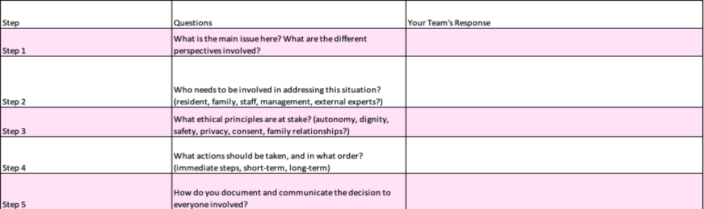
EXERCISE 2 – COMPLEX SITUATION
Instructions (25 min):
In small groups, read the proposed situation.
Use the 5-step answer sheet to build a team response.
Prepare a 2-minute presentation.

Slide 10
SUMMARY: KEY TAKEAWAYS
  The method is as important as the message.
  Language is a tool for inclusion – it can open or close doors
  Create a welcoming environment – ​​visible signs matter
  Adapt – there is no single solution
  Work as a team – the collective response is stronger

Slide 11
THANK YOU

