Slide 1
AgeWise Handbook
Module 4. The History of Societal Norms of Gender and Sexuality in Europe
Karina Hoßfeld - Association of Lower Saxony Educational Initiatives

Slide 2



That's what it's all about...
Images of old age-visibility and invisibility
Pedagogical Guidelines for Practice
Standards have grown historically
Factors influencing perceptions of ageing

Slide 3










To get started: a small constellation exercise…
I don't agree
at all
Sometimes I agree
I agree

Slide 4

Insight and benefit
Norms can be grown and changed historically What is considered "normal" today used to be different – and will continue to change. One's own convictions are socially shaped Irritation and discomfort have cultural causes, not individual deficits. Sexuality in old age is not a special case but part of lifelong identity development.

Slide 5
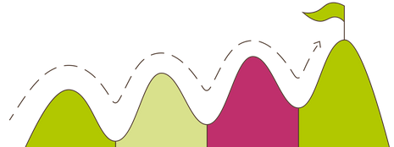
Objectives
Bildungs- und Fachkräfte profitieren, weil sie:
be able to moderate in a more diversity-sensitive way, reflect on one's own implicit norms, create learning spaces without embarrassment, be able to better classify conflicts between generations and give suggestions on how to deal with them, be able to deal more professionally with closeness, intimacy and boundaries, needs of older people and critically reflect on institutional rules and stimulate transformations.

Slide 6

Theoretical framework
Social norms
Social norms are basic rules and agreements,
that structure the behavior of individuals within a society.
They define what is considered appropriate, expected or deviating and have both a regulating and orienting effect.

Slide 7


Theoretical Framework: Historical Development of Social Norms on Age and Sexuality
Pre-modern societies:
Morality, religion and social order
Embedding Sexuality in Religious and Moral Order Systems.
It was primarily considered functional for reproduction.
Age was often associated with withdrawal, wisdom or spiritual devotion.
Sexuality in old age was not so much invisible as morally disqualified.
However, there were very few old or very old people at that time.

Slide 8


Theoretical Framework: Historical Development of Social Norms on Age and Sexuality
Early Modern Period: Disciplining and Science
Increase in state and church control over married life.
Around 1800: Strengthening of the medical view of the body and sexuality.
Increasing "medicalization" that examined the body, especially the female and "abnormal" body, as a medical object.
Postulate of the so-called "two-gender model": Women and men are fundamental, biologically based opposites.
From this, social roles are derived.
Deviations were no longer considered just a sin, but were increasingly classified as an illness or even a crime.

Slide 9
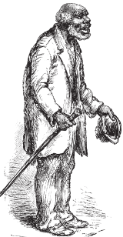
Theoretical Framework: Historical Development of Social Norms on Age and Sexuality
Modernity: Medical and Scientific Normalization
From the 18th century onwards: consolidation of the idea of two clearly separated sexes with "natural" characteristics.
Consideration of sexuality under medical and biological aspects.
Along with this: consolidation of the biological role consideration and
the idea of clearly distinguishable phases of life with specific functions.
Age was now often assessed as a deficit phase, characterized by physical decline and loss of function.
Sexuality in old age was no longer primarily morally condemned, but pathologized as no longer "age-appropriate" or assessed as a medical problem because it was perceived as inappropriate for old people.

Slide 10
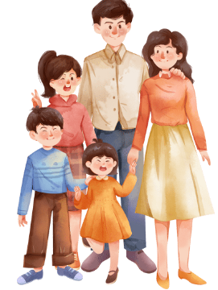

Theoretical Framework: Historical Development of Social Norms on Age and Sexuality
19th century: Bourgeoisness, pathologization and identity
Bourgeois society elevated the nuclear family to a moral ideal.
Sexual fidelity in marriage was enshrined as the norm.
Sharp separation of gender roles.

Slide 11

Theoretical Framework: Historical Development of Social Norms on Age and Sexuality
19th century: Bourgeoisness, pathologization and identity
Emergence of modern sexology and coining of terms such as "homosexuality" – initially as a medical diagnosis.
This was the first time that same-sex desire was understood as a stable identity, but mostly as deviation or degeneration.
Ambivalent consequences of categorization: it enabled visibility and self-description, but also led to stigmatization because it was associated with "illness".
Those affected tried to avoid the latter by unsuccessful treatment attempts, which were prescribed to them by some psychiatrists.

Slide 12

Theoretical Framework: Historical Development of Social Norms on Age and Sexuality
20th century full of contrasts
Industrialization, Urbanization and the First World War: Decay of Traditional Role Models.
A distinct gay/lesbian subculture emerged.
National Socialism: End of this development, consolidation of rigid gender norms and role models.
1935 Tightening of § 175 to make it easier to prosecute homosexual men.
The sexual revolution of the 1960s and 1970s: Questioning marriage, hetero-normativity and patriarchal gender orders.
Feminist movements fought for sexual self-determination and equality.
Lesbian, gay, and later trans* and inter* movements demanded social recognition.
Gender and sexuality were increasingly understood as social constructions, not just biological facts.

Slide 13
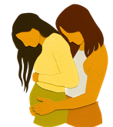


Theoretical Framework: Historical Development of Social Norms on Age and Sexuality
Present: Pluralization and Conflict
Europe Today: Diversity of Life Plans.
Same-sex marriages, legal recognition of trans* people in Germany since 2024.
Debates about non-binary genders stand for a profound change in social norms.
At the same time, there are counter-currents: pluralistic concepts of gender and sexuality are being questioned by religious, conservative and nationalist movements.
It becomes clear that norms are never final, but an expression of ongoing struggles for power and interpretation.

Slide 14
Factors influencing images of age
Cultural narratives about aging and "appropriateness"
Functions of Cultural Narratives:
Information transfer, communication, community building, the transmission of knowledge or simply entertainment.
They structure social ideas,
convey implicit expectations and
define what is considered "normal" or "deviant".
With regard to old age, narratives exist in our Western society that link aging with withdrawal, rest and need reduction.
"What I experience is that 60 is such a sound barrier. I have the impression that if something is desired, please should not be older than 60. I hear that more often. “
Participant of the focus group March 2025,
Germany

Slide 15

Factors influencing images of age
Cultural narratives about aging and "appropriateness"
Older people are primarily portrayed in roles such as grandparents, people in need of care or wise advisors.
Their physicality and sexuality tend to be faded out.
The image of an asexual phase of life emerges.
These narratives have an effect on several levels:
they influence the self-image of older people,
shape family expectations and
structure institutional frameworks.

Slide 16
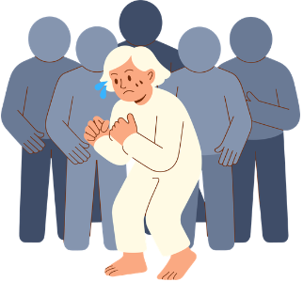
Factors influencing images of age
Cultural narratives about aging and "appropriateness"
Sexuality in old age is not openly rejected, but often tacitly excluded. This silence increases insecurity and self-censorship.
The construction of appropriateness thus functions as a social regulator.
It does not so much determine what is forbidden as what is not addressed.

Slide 17
Factors influencing images of age
Cultural narratives about aging and "appropriateness"
In this sense, cultural narratives are a central link between historically grown norms and current practices –
and thus a key to understanding the continuing taboo on sexuality in old age.

Slide 18


Factors influencing images of age
Media Representations of Age and Sexuality: Visibility, Stereotypes and Invisibility
Older people appear comparatively rarely in the media as sexual subjects.
When sexuality in old age is discussed, it often happens in specific forms of representation:
  as a humorous deviation,
  as a medical or psychological problem, or
  as a morally irritating event.

Slide 19
Factors influencing images of age
Media Representations of Age and Sexuality: Visibility, Stereotypes and Invisibility
Aging bodies are often portrayed as deficient, sick or in need of care, which means that they remain excluded from dominant sexuality discourses.
These representations contribute to the reproduction of stereotypical images in which sexual desires of older people are
either ridiculed,
problematized or
be completely negated.

Slide 20
Factors influencing images of age
A central feature of media representations is the invisibility
"This applies in particular to sexuality – it is practically invisible. Although we live in a society steeped in sexualized images and cues, they almost never affect older people. It's always about the young – because older people assume that nothing is going on anymore."
The widespread lack of realistic, diverse representations of sexuality in old age creates the impression that it is a marginal phenomenon or something socially irrelevant.
Invisibility has a normative effect: what is not shown does not appear to be intended.
As a result, sexuality is implicitly linked to youth, attractiveness and physical performance.
Participant of the focus group March 2025,
Germany

Slide 21
Factors influencing images of age
Media contribute to the codification of normative body images
The logic of representation influences not only social attitudes, but also professional contexts, for example in nursing, counselling or adult education, in which media images can be adopted without reflection.
The effect of media stereotypes is not limited to individual perceptions. They shape family expectations, institutional routines and political discourses.
Sexuality in old age is not explicitly prohibited in this way, but structurally marginalized.
The media thus make a significant contribution to the maintenance of social norms that construct aging and sexuality as contradictory.

Slide 22

Factors influencing images of age
Taboos, Silence and Institutional Practice
Sexuality in old age is a double taboo subject in many societies.
It encounters social norms that generally associate sexuality with youth, attractiveness and performance,
and age-related notions of seclusion, wisdom, or moral appropriateness.
The result is often silence – both in families and in institutional contexts.
This silence does not lead to neutrality, but to uncertainty, discomfort and structural marginalization.

Slide 23
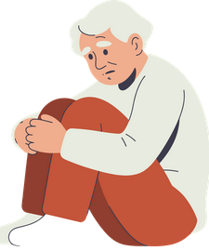
Factors influencing images of age
Taboos, Silence and Institutional Practice
In family contexts, the taboo often expresses itself in subtle signals: desires, intimacy needs or sexual experiences of older people are not addressed or tacitly devalued.
Professionals in nursing, counselling or social work often experience this spiral of silence as a challenge. They have to weigh up professional restraint, ethical responsibility and the need of those affected for recognition of the reality of their lives.
A lack of education and training on this topic increases uncertainty and inhibitions.

Slide 24
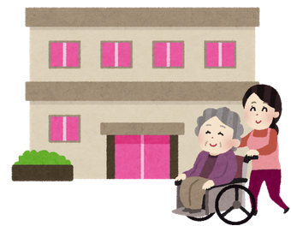

Factors influencing images of age
Taboos, Silence and Institutional Practice
Institutionally, taboos are reinforced by structures and rules.
Institutions such as nursing homes or counselling centres often do not have clear guidelines for dealing with sexuality in older people.
There is a lack of spaces, resources or guidelines for thematic integration into education or care services.
As a result, it can lead to stagnation, normative self-censorship or even inappropriate reactions to the needs of older people.

Slide 25

Factors influencing images of age
Taboos, Silence and Institutional Practice
The analysis of such taboo patterns shows that silence does not arise by chance, but is stabilized by social, historical, and institutional mechanisms.
Education and training modules can play a key role here: By reflecting on their own attitudes, deconstructing dominant narratives and discussing case studies, participants are enabled to consciously address taboos.
They learn to name uncertainties, critically question normative expectations and develop action-oriented strategies that meet the needs of older people.

Slide 26
Guidelines for Pedagogical and Nursing Professionals
Do | Don’t
Actively reflect on your own assumptions | Ignoring or trivializing sexuality in old age
Recognizing diversity of life plans | Using humor at the expense of the elderly
Consciously making one's own language inclusive | Making normative statements ("At that age it's ...")
Openly name uncertainties ("This is a sensitive topic...") | Addressing intimate topics without consent
Use further education and training | Generalizing cultural or religious attributions

Slide 27

Guidelines for Pedagogical and Nursing Professionals
Communication recommendations
The attitude is characterized by the basic assumption: sexuality in old age is possible.
Open questions that allow a wide range of answers are favourable in dialogue. These should be value-free.
Leading questions should be avoided.
Pauses, uncertainties and silence may be allowed and endured.
How a person defines themselves should be respected and not questioned.

Slide 28

Guidelines for Pedagogical and Nursing Professionals
Key Principles
Describing instead of evaluating
Separating observations from interpretations.
Avoid labels (e.g. "inappropriate").
Using "I" messages
Make your own perceptions, feelings and needs transparent.
No generalizations or recriminations.
Openness to different perspectives
Accept that there is no one right point of view.
Asking instead of insinuating.
No implicit norms or "man messages"
Respect autonomy.
Offers instead of instructions.

Slide 29
Guidelines for Pedagogical and Nursing Professionals
Key Principles
Recognition of feelings – without judgment
Accept feelings, even if you don't share them.
Using inclusive and precise language
  No generalizations about groups or people.
  Sensitivity to power relations and roles
Understanding, not correcting
  Understanding communication as a joint clarification process.
  Not: "Correct“, but focus on relationship and understanding.

Slide 30
Thank you

Slide 31
References
Ariès, P. (1988). Geschichte des privaten Lebens. Frankfurt a. M.: Fischer.
Beck-Gernsheim, E. (1980): Das halbierte Leben: Männerwelt Beruf, Frauenwelt Familie. Frankfurt a.M.
Berger, P. L., & Luckmann, T. (2016). Die gesellschaftliche Konstruktion der Wirklichkeit. Frankfurt a. M.
Butler, J. (1991). Das Unbehagen der Geschlechter. Frankfurt a. M.
Dimbath, O. (2025): Soziale Norm. In: https://www.socialnet.de/lexikon/Soziale-Norm
Fealy, G., McNamara, M., Treacy, M. P., & Lyons, I. (2012). Constructing ageing and age identities: A case study of newspaper discourse. Ageing & Society, 32(1), 85–102.
Feldmann, M., Wazinski, K., Wanka, A. (2025): Intersektionale Perspektiven auf Alter(n) und Geschlecht in der Sozialen Arbeit
Foucault, M. (1999). Der Wille zum Wissen. Sexualität und Wahrheit 1. Frankfurt a. M.
Goffman, E. (1977). Stigma. Über Techniken der Bewältigung beschädigter Identität. Frankfurt a. M.
Honneth, A. (2010). Das Ich im Wir. Berlin
Somers, M. R. (1994). The Narrative Constitution of Identity. Theory and Society, 23(5), 605–649.
Woodward, K. (2006). Aging and Its Discontents. Bloomington: Indiana University Press.

