Slide 1



Module 3 – Sexuality, Gender, and Diversity
Supporting LGBTQIAP+ seniors: Awareness and proactive measures
Never Gets Old– Erasmus+ Project KA220-ADU

Slide 2
SESSION GOALS
By the conclusion of this session, you will have the ability to:
  Differentiating between sexual orientation, gender identity, and gender expression
  Understanding the life experiences of LGBTQIAP+ older adults
  Examining the intersection of discrimination
  Utilize inclusive language and stance.

Slide 3
PROGRAMME
1. Introduction
2. What is the reason for a specific module?
3. Activity – The terminology of inclusion
4. Intersectionality and Case Analyses
5. Physical Activity – Brett Case Analysis
6. Summary and assessment

Slide 4
WHY IS THERE A SPECIFIC MODULE ON LGBTQIAP+ SENIORS?
A single observation:
  LGBTQIAP+ seniors often go unrecognized in training programs, the media, and various institutions.
  They have experienced a history marked by criminalization, stigmatization, and HIV.
A consequence:
  Isolation: 90% are childless, 40% survive on less than €1000/month
  Fear: 65% fear violence within institutions
  "Back in the closet": 40% conceal their identity in nursing homes

Slide 5
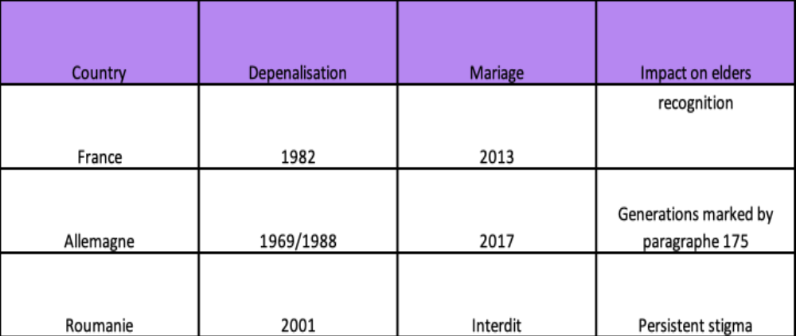
A LEGACY THAT CONTINUES TO BEAR SIGNIFICANT WEIGHT
HIV/AIDS crisis: Currently, 30% of HIV diagnoses in France involve individuals over the age of 50.

Slide 6
THE "RETURN TO THE CLOSET"
What is the reason for this phenomenon?
  Fear of being discriminated against
  Absence of apparent indicators of inclusion
  Past unfavorable experiences
  Insufficient trained staff
CONSEQUENCE:
51%
LGBT seniors experience total isolation.

Slide 7
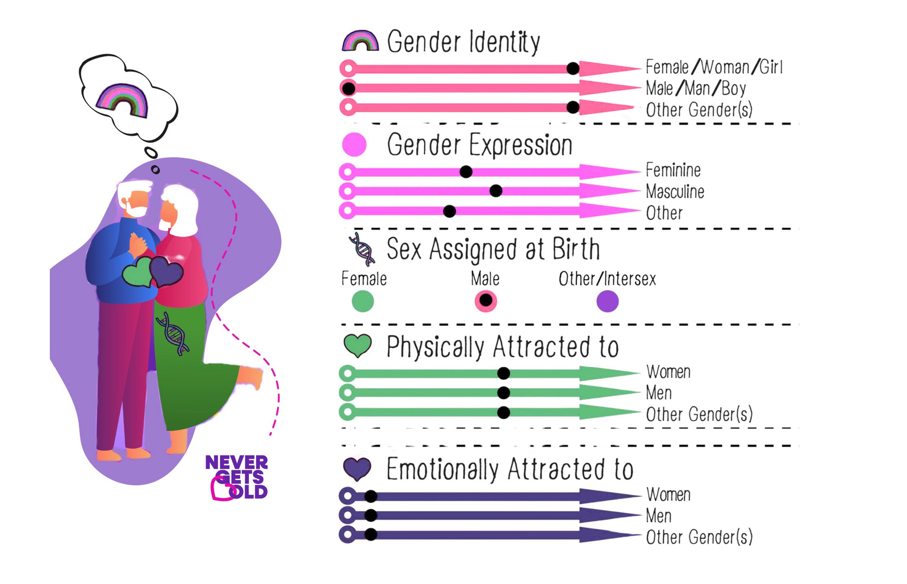

Slide 8



MOTIVATING PROJECTS
Maison de la Diversité (Lyon) – Housing that is inclusive and participatory
Grey Pride – "Welcome" sign for care facilities
Living Space Diversity (Berlin) – LGBT senior housing
INCLUSION IS NOT MERELY AN ABSTRACT IDEA; IT REPRESENTS A SERIES OF TANGIBLE DECISIONS.

Slide 9
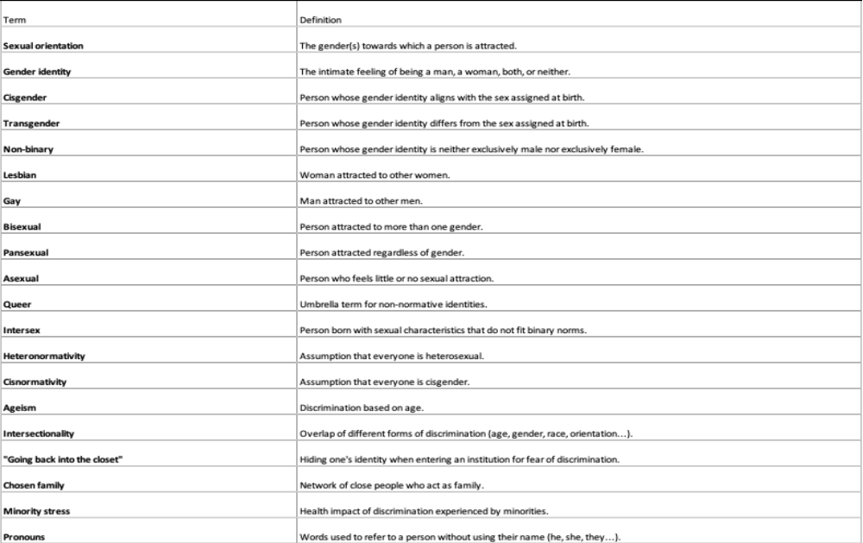
GLOSSARY OF IMPORTANT TERMS

Slide 10
EXERCISE 1 – THE LEXICON OF INCLUSION
Objective: To grasp the essential terminology and recognize their significance.
Order:
  In small groups, review the scenario(s).
  For every situation, engage in a discussion:
    Which term holds the greatest relevance?
    Why does this matter?
    In what ways can a deficiency in knowledge be detrimental?
Time: 20 minutes (10 minutes in group + 10 minutes for sharing)

Slide 11
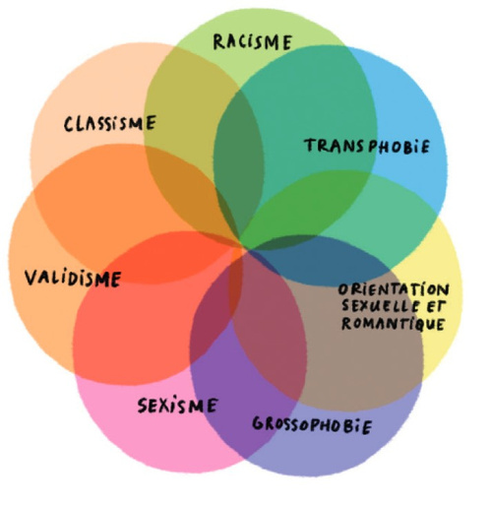
INTERSECTIONALITY: COMPREHENDING INTRICACY
Intersectionality refers to the concept that different forms of discrimination do not simply accumulate; rather, they interact and amplify one another.
Simone, 78 years of age, identifies as a lesbian.
  Ageism, sexism, and lesbophobia result in the complete erasure of her grief and her narrative.

Slide 12








EXERCISE 3 – CASE STUDY
  Brett, 72, is a transgender man residing in Lyon. He sports a full beard, possesses a low voice, and underwent chest surgery (mastectomy) several years ago. However, he has not had gender-affirming surgery. As a result, his body reflects the distinct marks of a personal transition journey.
  After a career in education and a life characterized by intricate family dynamics (he spent his adolescence in foster care), Brett resides alone. Recently, a fall and the emergence of heart issues have compelled him to hesitantly contemplate moving into a nursing home.
  During a pre-admission visit, the director refers to him as "Monsieur." Brett feels acknowledged. However, when the nurse coordinator brings up the topic of personal care and daily assistance, Brett experiences unease. He understands that one day, possibly soon, a caregiver will encounter his unclothed body, revealing a narrative that his outward appearance does not convey.
  "I have spent the majority of my life in institutions. It has never frightened me. However, I will not end up in a nursing home like my mother did."
Inspired by The Atlantic (2015), "The Difficulties of Being Transgender in a Nursing Home"
BRETT,
72 years old

Slide 13
EXERCISE 3 – CASE STUDY
1.WHAT ARE THE PRIMARY CHALLENGES IN THIS SITUATION?
FOR BRETT PERSONALLY, FOR THE NURSING TEAM, FOR THE FACILITY
2. WHAT ASSUMPTIONS OR BIASES COULD AFFECT THE STAFF'S RESPONSE UPON DISCOVERING BRETT'S BODY?
3. WHAT ARE THE POTENTIAL RISKS IF THE INSTITUTION OVERLOOKS THE SITUATION AND FAILS TO IMPLEMENT ANY MEASURES IN ADVANCE?
4. WHAT MIGHT A RESPECTFUL AND PERSON-CENTERED RESPONSE ENTAIL?
WHAT ACTIONS SHOULD MANAGEMENT TAKE PRIOR TO BRETT'S ARRIVAL?
WHAT ACTIONS SHOULD THE CAREGIVER TAKE WHILE PROVIDING CARE?
WHAT POLICIES OR PROTOCOLS MIGHT BE BENEFICIAL?
5. WHAT ACTIONS CAN THE INSTITUTION TAKE TO ENSURE THAT BRETT DOES NOT HAVE TO "EXPLAIN WHO HE IS" AGAIN?
  Brett, 72, is a transgender man residing in Lyon. He sports a full beard, possesses a low voice, and underwent chest surgery (mastectomy) several years ago. However, he has not had gender-affirming surgery. As a result, his body reflects the distinct marks of a personal transition journey.
  After a career in education and a life characterized by intricate family dynamics (he spent his adolescence in foster care), Brett resides alone. Recently, a fall and the emergence of heart issues have compelled him to hesitantly contemplate moving into a nursing home.
BRETT,
72 years old
  During a pre-admission visit, the director refers to him as "Monsieur." Brett feels acknowledged. However, when the nurse coordinator brings up the topic of personal care and daily assistance, Brett experiences unease. He understands that one day, possibly soon, a caregiver will encounter his unclothed body, revealing a narrative that his outward appearance does not convey.
  "I have spent the majority of my life in institutions. It has never frightened me. However, I will not end up in a nursing home like my mother did."
Inspired by The Atlantic (2015), "The Difficulties of Being Transgender in a Nursing Home"

Slide 14
EXERCISE 3 – CASE STUDY
1.WHAT ARE THE PRIMARY CHALLENGES IN THIS SITUATION?
FOR BRETT PERSONALLY, FOR THE NURSING TEAM, FOR THE FACILITY
2.WHAT ASSUMPTIONS OR BIASES COULD AFFECT THE STAFF'S RESPONSE UPON DISCOVERING BRETT'S BODY?
3. WHAT ARE THE POTENTIAL RISKS IF THE INSTITUTION OVERLOOKS THE SITUATION AND FAILS TO IMPLEMENT ANY MEASURES IN ADVANCE?
4. WHAT MIGHT A RESPECTFUL AND PERSON-CENTERED RESPONSE ENTAIL?
WHAT ACTIONS SHOULD MANAGEMENT TAKE PRIOR TO BRETT'S ARRIVAL?
WHAT ACTIONS SHOULD THE CAREGIVER TAKE WHILE PROVIDING CARE?
WHAT POLICIES OR PROTOCOLS MIGHT BE BENEFICIAL?
5. WHAT ACTIONS CAN THE INSTITUTION TAKE TO ENSURE THAT BRETT DOES NOT HAVE TO "EXPLAIN WHO HE IS" AGAIN?

Slide 15
SUMMARY: MAIN POINTS
SEXUALITIES, GENDERS, AND DIVERSITIES - MODULE 3
  History is significant – LGBTQIAP+ seniors have faced criminalization, HIV, and stigmatization. Overlooking this history continues to foster violence.
  The phenomenon of "returning to the closet" is a reality, as 40% of LGBTQIAP+ seniors conceal their identity in nursing homes due to concerns about discrimination.
  Intersectionality is essential for comprehension – Discriminations do not simply accumulate; they compound (age + gender + orientation + race).
  Solutions are available – Maison de la Diversité, Grey Pride label, Lebensort Vielfalt. Inclusion is established through tangible decisions.
  Language serves as a means of inclusion – Pose the appropriate questions, avoid assumptions, and utilize neutral terminology.

Slide 16
THANK YOU.

