Slide 1
AgeWise Handbook
Module 2: Ageism and Misconceptions About the Elders
Developed by Elisa Klein-Peters | Proportional Message

Slide 2
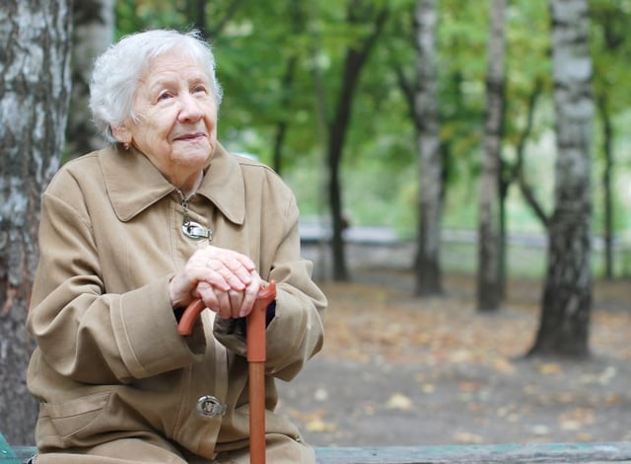
Agenda & Learning Outcomes
Effects of Ageism
Levels of Ageism
  Institutional Ageism
  Interpersonal Ageism
  Internalised Ageism
Negative Societal Beliefs and Taboos surrounding Sexuality in Later Life
Impact on Healthcare, Education and Institutional Settings
Vulnerable Groups and Intersectionality
Guidance for Educators and Professionals
What will learners know or be able to do?
Identify and define the levels of ageism and their impact.
Recognise the gap between explicit professional approval of sexual rights and implicit personal biases.
Understand how gender, culture, and cognitive status overlap to create barriers to intimacy.
Challenge the Asexual Stereotype and the prioritisation of safety over the adult right to privacy.
This photograph by an unknown author is licensed under CC BY-NC-ND.

Slide 3
Effects of Ageism
From the pressure to dye away every grey hair to anti-aging products, the message is clear: Youth seem to be the standard of value and being old is something to avoid.
Sexual health, identities, and intimacy are essential to older adults’ quality of life, yet many believes and misconceptions exists within societies regarding sexuality in older age. While our society has worked hard to stop discrimination based on things like race or gender, prejudice against older people is still often ignored or even seen as “normal” (Abrams, 2023).
Ageism refers to the stereotypes, how we think, prejudice, how we feel, and discrimination, how we act, towards others or oneself based on age (WHO, 2025). While explicit ageism is consciously and intentionally, implicit ageism operates largely outside of conscious awareness and conscious intention.
Notes:
It is important to recognise that age-based bias is a universal phenomenon that can affect individuals at any stage of life. Ageism occurs whenever stereotypes, prejudice, or discrimination are directed toward people based on their age. A Note on Focus: While ageism impacts all generations, Module 2 focuses specifically on ageism directed toward older adults. This alignment ensures that our training directly supports the mission of the Never Gets Old project, addressing the unique systemic barriers and taboos that hinder the sexual rights and holistic well-being of the elderly population.

Slide 4
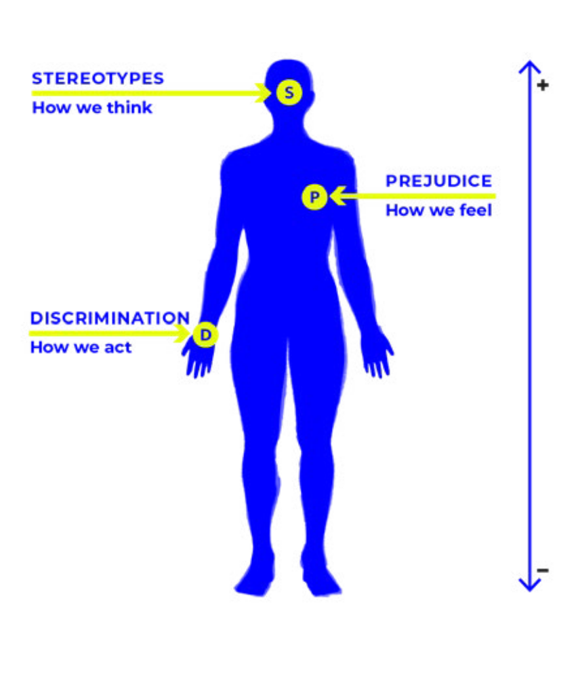
Effects of Ageism – in older people’s lives.
Ageism is known to affect older people’s lives in terms of their health and well-being and represents a big obstacle to healthy ageing.
It is associated with:
  poorer physical health (Robb et al., 2002)
  poorer mental health (Lyons et al., 2018)
  poorer quality of life (Bodner & Cohen-Fridel, 2019)
  higher rates of loneliness and social isolation (Donizzetti & Lagacé, 2022).
  experiences of ageism are greater among those without a partner, unemployed participants, those with lower incomes and poorer self rated health (Heywood et al, 2019)
Figure 1 - The three dimensions of ageism, including stereotypes, prejudice and discrimination (WHO, 2021).

Slide 5
Three Levels of Ageism
Ageism is a multi-layered phenomenon; it exists in the laws of our countries, within interactions in the hallways, and even the quiet thoughts in our own heads.
It is not just a personal feeling; it is built into our systems and can be categorised into three distinct levels:
Institutional Ageism
The Systemic Level
Interpersonal Ageism
The Social Level
Internalised Ageism
The Personal Level

Slide 6
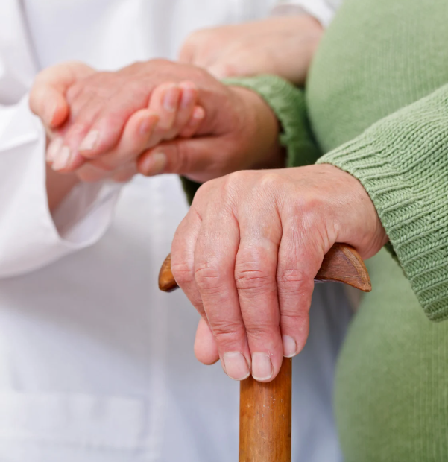
Institutional Ageism - The Systemic Level
Laws, rules, social norms, and practices of organisations that limit opportunities or disadvantage individuals based on their age (WHO, 2021).
Often the most invisible form
Example: The age cap on certain screenings in the health care system. In many regions, routine sexual health screenings or reproductive health checks are automatically stopped once a patient hits 65, under the ageist assumption that they are no longer sexually active or at risk for STIs.
Example: Discriminatory hiring practices that favour younger candidates or mandatory retirement ages that force skilled professionals out of their roles regardless of their actual competence.

Slide 7

Interpersonal Ageism - The Social Level
Involves the stereotypes and prejudices that emerge when one person interacts with another (WHO, 2021).
Example: Staff members make jokes about two residents starting a new romantic relationship.
Example: Adopting an overly accommodating tone or simplified vocabulary with older adults, known as elderspeak, we infantilise older adults, reinforcing a social perception of incompetence that often leads to disrespectful treatment.
Notes:
Even if intended as harmless fun, these comments signal to the older adult that their desire for intimacy is a source of amusement, which creates a culture of shame and discourages residents from seeking the social connections they need for their well-being.

Slide 8

Internalised Ageism - The Personal Level
Also known as self-directed ageism, individuals take the negative stereotypes they have heard throughout their lives and turn them inwards.
Example: An older woman who experiences physical discomfort, such as vaginal dryness, or feels a desire for a new partner. If she has internalised the message that she is “too old” to be attractive, she may never seek medical treatment or pursue a relationship.
Example: individuals in their twenties may internalise the belief that they lack sufficient life experience for a role or work position, leading them to disqualify themselves from career opportunities.
Notes:
Older adults begin to believe that the myths about ageing are actually true for them and stop themselves from accessing joy or health because they feel they no longer qualified for those experiences.

Slide 9
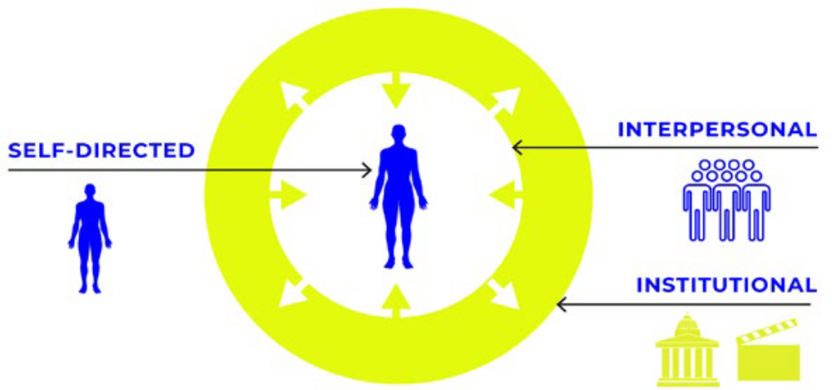
Three Levels of Ageism
These three levels do not exist in isolation; they feed into one another.
Institutional lack of sexual health focus reinforces the Interpersonal idea that seniors aren't sexual, which eventually leads to the Internalised belief that one shouldn't even ask for help. Breaking the cycle requires professionals to intervene at all three levels simultaneously.
Figure 2 - The three levels of ageism (WHO, 2021).

Slide 10
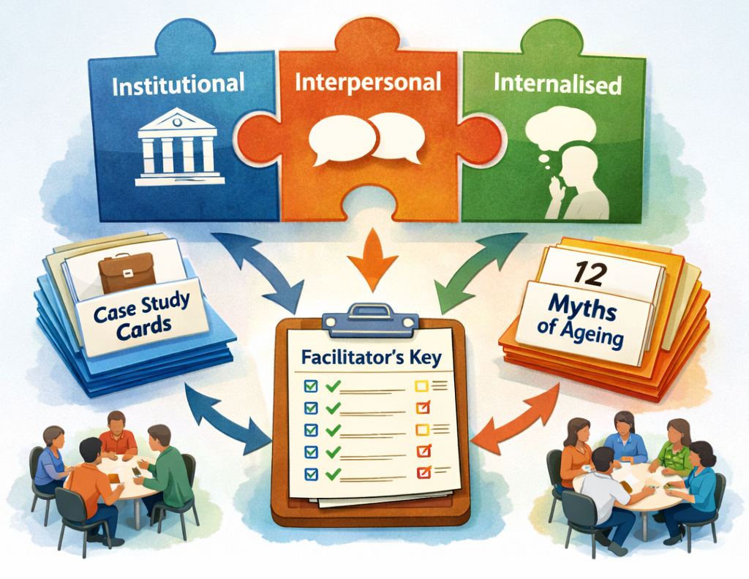
Three Levels of Ageism
Exercise 1 – The Ageism Puzzle
Objective: Learners will identify how 12 Myths of Ageing (WHO, 2013) manifest across Institutional, Interpersonal, and Internalised levels of ageism through real-world scenarios.
In small groups, read the following 12 mini case studies. Identify which level of ageism is present and which of the 12 Myths are being reinforced.

Slide 11

Negative Societal Beliefs and Taboos surrounding Sexuality
In many cultures, the intersection of old age and sexuality creates a profound social discomfort. This discomfort is rooted in several societal beliefs that professionals must learn to identify and challenge.
Sexual Ageism is the belief that older people are, or should be, asexual, that sexual interest in old age is abnormal. It occurs when older people are stereotyped as being non-sexual, not capable of having sex or enjoying a sex life like they did when they were young (Surles, 2023).

Slide 12
Negative Societal Beliefs and Taboos surrounding Sexuality
The "Asexual" Assumption | The Sacredness of the Delicate Body | The Double Standard of Ageing and Gender | The Silence of the Closet
The most pervasive belief is that sexual desire naturally expires at a certain age. This taboo suggests that once an individual passes reproductive age or faces physical health declines, they become asexual. This taboo prevents older adults for example, from discussing sexual health health professionals. | There is a societal tendency to view the aging body through a lens of fragility that is incompatible with sex. We often see older adults exclusively as grandparents or patients. These roles are culturally de-sexualized. In institutional settings, this taboo manifests when staff feel they are protecting a resident's dignity by ignoring their sexual identity. | Men are often allowed a longer sexual runway in the public eye, while women face a double standard where aging is equated with a loss of sexual value. This is reinforced by a multi-billion-euro anti-aging industry that labels the natural signs of a life lived, wrinkles, grey hair, changing body shapes, as problems to be fixed. | For LGBTQI+ elders, these taboos are doubled. Many lived through eras where their identities were criminalised. Societal taboos force many back into the closet when entering aged care (e.g. elders living with HIV feel compelled to return to the closet, driven by a lack of knowledge among medical staff regarding HIV treatments/transmissibility).

Slide 13
Negative Societal Beliefs and Taboos surrounding Sexuality
Myth | Reality
"Older people don't have sex." | National surveys show that a significant percentage of adults aged 70+ remain sexually active and value intimacy. At the same time, sexual satisfaction often increases or stays stable with age. While the mechanics may change, the emotional intimacy and confidence often deepen.
"Older bodies are unattractive and non-sexual." | Beauty is a social construct. Attractiveness in later life is often tied to vitality and connection rather than "flawless" skin.
"If they can't have intercourse, their sex life is over." | This is the Hegemony of Penetration. Sexuality includes touch, kissing, masturbation, and emotional closeness. These remain vital even if physical disabilities occur.
"Sex is dangerous for the heart." | Sexual activity is no more strenuous than walking up two flights of stairs; for most, it is a safe, healthy exercise.
"Dementia makes you asexual." | The need for touch and connection is one of the last things to fade. Sexuality remains a core part of identity even with cognitive decline.
"STIs aren't a concern for people over 65." | Because of the Asexual Myth, older adults are less likely to use protection or be tested. Rates of STIs in older populations have risen significantly because doctors fail to discuss safe sex with them.
"LGBTQI+ seniors go back in the closet." | While many do out of fear, this is a failure of the institution's culture, not a choice by the individual.

Slide 14
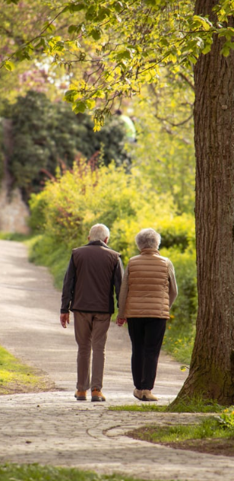
Shades of Grey (Gewirtz-Meydan & Ayalon, 2020)
These taboos create a circle of silence:
Older adults stay silent to avoid being seen as gross or difficult.
Professional stay silent to avoid awkwardness or disrespect.
The family stays silent to maintain a specific image of their parent.
Gewirtz-Meydan and Ayalon asked 135 participants to freely describe how they believe sexuality changes in old age, allowing for honest, complex, and sometimes raw opinions to emerge.
The study identified five major themes that illustrate the spectrum of public opinion, ranging from negative to hopeful and transformative. The researchers found that while explicit ageism is declining, sexual ageism remains deeply rooted in the public’s imagination.

Slide 15
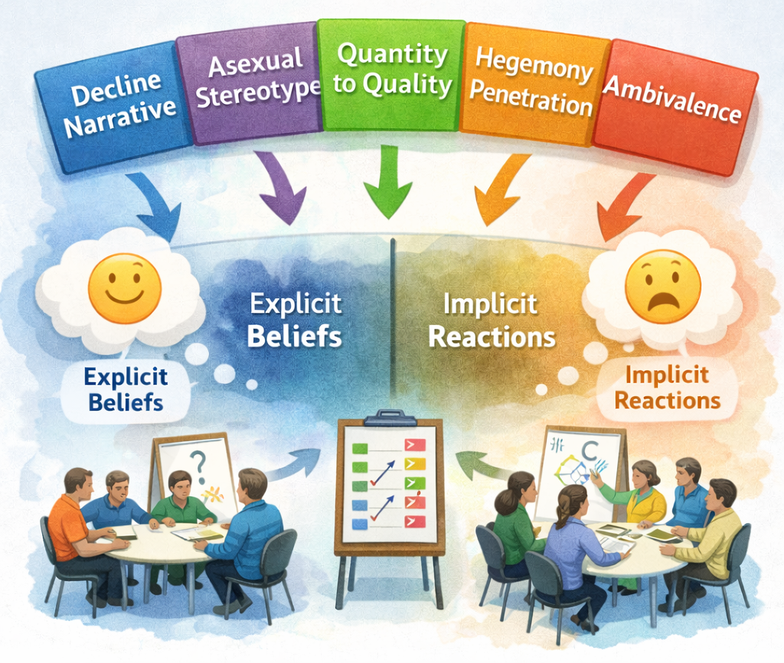
Shades of Grey (Gewirtz-Meydan & Ayalon, 2020)
Exercise 2 – Shades of Grey
Objective: To help professionals recognise gaps between their explicit (conscious/polite) beliefs and their implicit (unconscious/gut) reactions using 5 major research themes.
Each group takes one of the five theme card. Groups will discuss:
Where have we seen this in our facility?
Anything comes to mind when connecting the theme to any explicit or implicit ageist act?

Slide 16

Bias Impact on Healthcare, Education and Institutional Settings
In healthcare, ageist biases often lead to therapeutic nihilism, the belief that treating an older person’s condition is a waste of resources. This results in the under-diagnosis of treatable conditions, such as depression or sexual dysfunction, which are dismissed as "normal" ageing.
In educational settings, older adults are frequently excluded from modern curricula or technological training due to the digital ageism myth; the assumption they cannot or will not learn new skills.
When institutions prioritise safety over autonomy, they treat older adults as passive recipients of care rather than active participants in life.
Notes:
Bias against older adults is not just an attitude; it is a systemic force that shapes the quality of care and education.

Slide 17
Professional Challenges: Navigating the Protector’s Paradox
Protector’s Paradox: a practitioner may feel that by ignoring or discouraging a resident’s sexual expression, they are protecting them from falls, STIs, or family disapproval.
Other challenges include:
Managing adult children who may be uncomfortable with their parent’s new romantic interest or gender transition.
Feeling of not being equipped to discuss sexual health or LGBTQI+ identities because this was never covered in their professional training.
Rigid schedules for feeding, cleaning, and medicating that leave no room for private time or the "messy" reality of human relationships.
What are your challenges?
Notes:
Professionals in care and social services often face a set of ethical and practical hurdles when confronting sexual ageism. One of them is the Protector’s Paradox. In reality, this protection often violates the individual's right to self-determination.

Slide 18
Vulnerable Groups and Intersectionality
Intersectionality is the framework that helps us see how different forms of discrimination (like racism, homophobia, and ageism) overlap to create unique experiences of marginalisation.
LGBTQI+ Elders: Many have spent decades surviving in a world that pathologised their identities. When they enter aged care, they often face double invisibility. They are invisible as sexual beings because they are old, and invisible as queer beings because they are in an environment that assumes everyone is heterosexual.
People with Dementia: This group is particularly vulnerable to sexual infantilisation. Staff may view any expression of intimacy as a behavioural symptom to be suppressed rather than a human need for connection. Ethical care here requires a delicate balance of assessing capacity without defaulting to a total ban on touch.
Notes:
To understand the impact of ageism, we must recognise that Older Adults is not a monolithic group.

Slide 19
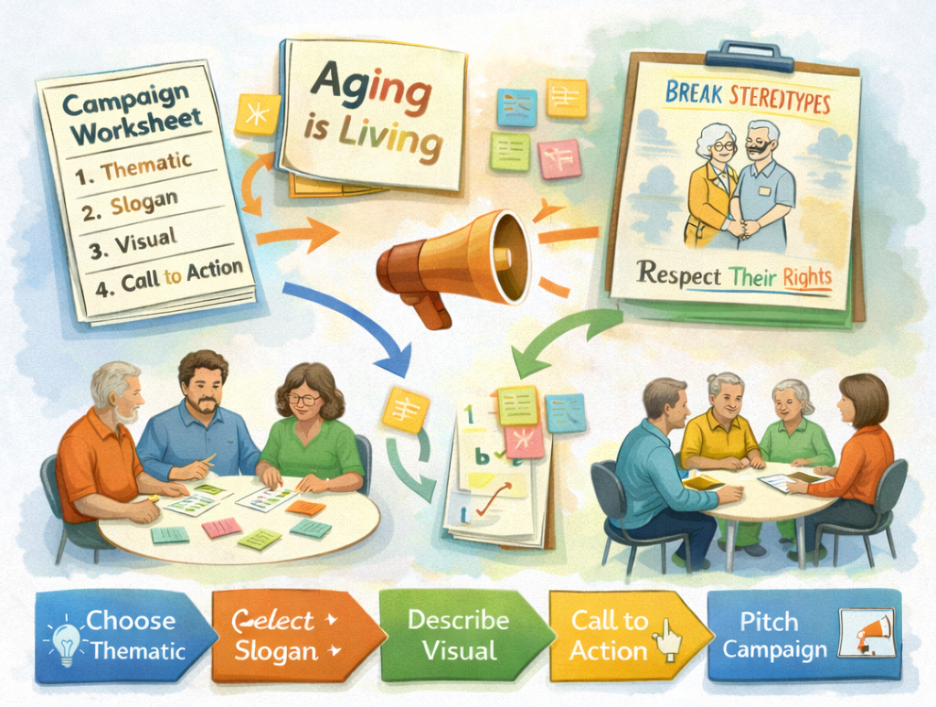
Reimagining the Narrative
Exercise 3 – A Media Campaign Workshop
Objective: To empower learners to create counter-narratives that challenge ageist media content and promote the sexual rights and diversity of older adults.
Activity: Using the worksheet as a guide, groups move through a creative process:
1. Choose a thematic (e.g. a myth)
2. Select a powerful slogan
3. Describe a visual - what does the image look like?
4. Groups sketch a rough version of their poster or social media post. Define a specific Call to Action: What is the one concrete thing you want a professional or a family member to do differently after seeing your campaign?
5. Each group pitches their campaign.

Slide 20
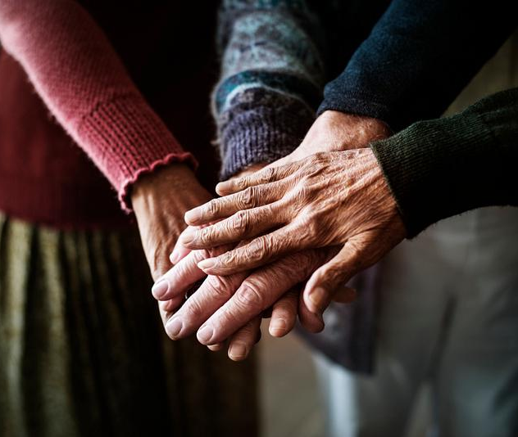
Guidance for Educators and Professionals
Ethical Considerations & Communication
Implicit Ageism is more dangerous because it is unconscious. It is the gut feeling of awkwardness you might feel when seeing an older couple kiss. To combat this, we must practice bias-literacy, which means questioning why we feel uncomfortable.
Bias-literacy: "Would I react this same way if this person were 30 years old?"
One of the hardest challenges is when a resident’s family objects to their romantic life. Remind families that their parent remains an adult with the right to privacy and self-determination.
"We understand this is a change for the family, but your father’s emotional well-being and his right to form connections are our priority here."
Notes:
Bias-literacy is the ability to recognise ageist triggers.

Slide 21
Guidance for Educators and Professionals
Do | Don’t
Use the person's preferred name, e.g. "John". "Mr." and "Mrs." may be problematic for some transgender individuals. | Don’t use Elderspeak or diminutive terms (e.g., "Sweetie," "Honey," "Young man").
Do maintain professional neutrality. Document a new relationship as a "positive social connection." | Don’t react with shock, disgust, or nervous laughter if you witness an older couple being physically affectionate.
Use open questions: "Who are the important people in your life right now?" | Never assume someone is heterosexual or past having sexual needs.
If a resident comes from a culture where sexuality is a deep taboo, focus on comfort and privacy. | If a resident comes from a culture where sexuality is a deep taboo, do not force a western clinical conversation.
Normalise the conversation and include sexual health questions in routine assessments. If the professional treats it as normal, the resident will feel safe. | Don’t skip questions about sexual health or STIs because the patient is "too old" for it to be relevant.
Do use gender-neutral language: "Did you have a partner or a significant person in your life?" | Don’t assume a widowed resident is heterosexual. Avoid asking "What was your husband's name?"
Do distinguish between inappropriate behaviour and an unmet need for connection. Look for ways to provide safe, consensual touch or sensory comfort. | Don’t assume a person with dementia has lost the need for touch.

Slide 22
How to Avoid Stereotypes:
Your role is not to be a moral gatekeeper but a facilitator of dignity. By checking your bias, respecting privacy, and using adult language, you create an environment where older adults feel safe enough to be their whole selves.
While someone may be a grandparent, that is not their only identity. Treat them as an individual with a history, gender, and a sexual identity.
If you hear a colleague making a joke about grandpa's new girlfriend, gently intervene: "Actually, it’s great to see him so happy; connection is important at any age."
During health checks, say: "Many people find that their sexual needs change as they get older. Is there anything in that area you’d like to talk about?" This lowers the barrier for the older adult to speak.

Slide 23
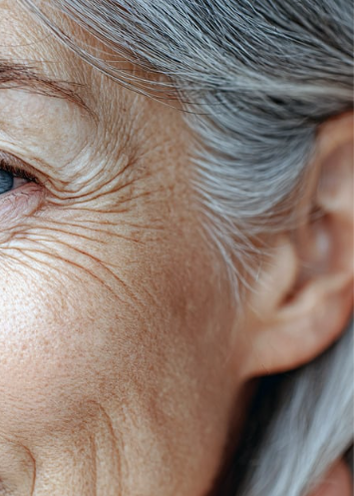
Summary and Key Messages
Ageism is not just unkind, it can lead to medical errors, missed diagnoses, and the violation of human rights. Recognising bias is a fundamental professional competency.
Research shows that intimacy and sexual interest remain vital components of quality of life. The end of a sex life is often a result of societal stigma.
In institutional settings, privacy is the prerequisite for dignity. Professionals must transition from gatekeepers who monitor behaviour to facilitators who protect a resident's private space.
We cannot support older adults without acknowledging their diverse backgrounds.
Combatting ageism is an ongoing process of self-reflection. By auditing our language and our reactions, we create a culture where older adults can age with their identities intact.
Final Thought: If we have the good fortune to live a long life, the ageist stereotypes we challenge today are the very ones that would have harmed us tomorrow. Inclusive care is an investment in our collective future.

Slide 24
Module 2 – Key Definitions
Ageism: Refers to the stereotypes (how we think), prejudice (how we feel) and discrimination (how we act) towards others or oneself based on age (WHO, 2025).
Stereotypes: Cognitive structures that store our thoughts, beliefs and expectations about the characteristics of members of social groups. In the case of ageism, age stereotypes are used to make inferences about, and guide behaviour towards, people of a given age group (WHO, 2021).
Prejudice: An affective reaction or feeling that is directed towards an individual who belongs to a specific social group. In the case of ageism, prejudice is directed towards individuals perceived to belong to a specific age group, regardless of whether they actually belong to that group (WHO, 2021).
Discrimination: Any actions, practices, laws or policies that are applied to people based on their perceived or real membership in a socially salient group and that impose some form of direct or indirect disadvantage (negative discrimination) or advantage (positive discrimination) on them. In the case of age-based discrimination, these actions, practices and policies are directed at people perceived to belong to a specific age group (WHO, 2010).
Institutional Ageism: Laws, rules, norms, policies and practices of institutions – and the ideologies that are fostered to justify them – that unfairly restrict opportunities, and systematically disadvantage individuals based on their age (WHO, 2021).

Slide 25
Module 2 – Key Definitions
Interpersonal Ageism: Ageism occurring during interactions between two or more individuals. In interpersonal ageism, the perpetrator is distinguished from the target of ageism (WHO, 2021).
Internalised Ageism / Self-directed Ageism: Ageism turned against oneself. People internalise biases based on age from the surrounding culture after being repeatedly exposed to them, and they then apply the biases to themselves (WHO, 2021).
Explicit Ageism: Ageism that is consciously and intentionally engaged in by a person. It is often contrasted with implicit ageism, which operates largely outside of conscious awareness (WHO, 2021).
Implicit Ageism: Ageism that is engaged in by a person without conscious awareness and intention (WHO, 2021).
Sexual Ageism: The specific belief that older people are, or should be, asexual, that sexual interest in old age is abnormal and not capable of having sex or enjoying a sex life like they did when they were young (Surles, 2023).
Elderspeak: Adjustments to speech patterns that are sometimes made by younger people when communicating with older adults, such as speaking more slowly or more loudly, shortening sentences or using limited or less complex vocabulary. These simplified speech patterns are implicitly based on the assumption that older adults are cognitively impaired or incapable of understanding normal speech (WHO, 2021).

Slide 26



Thank you for your attention!
www.nevergetsold.eu
Never Gets Old
nevergetsold.project

Slide 27
Module 2: Ageism and Misconceptions About the Elders
References
Abrams, Z. (2023, March 1). A new concept of aging. Monitor on Psychology, 54(2). https://www.apa.org/monitor/2023/03/cover-new-concept-of-aging
Bodner, E.; Cohen-Fridel, S. Relations between Attachment Styles, Ageism and Quality of Life in Late Life. Int. Psychogeriatr. 2010, 22, 1353–1361.
Donizzetti, A.R.; Lagacé, M. COVID-19 and the Elderly’s Mental Illness: The Role of Risk Perception, Social Isolation, Loneliness and Ageism. Int. J. Environ. Res. Public Health 2022, 19, 4513.
Gewirtz-Meydan, A., & Ayalon, L. (2020). “Shades of grey”: Exploring public opinion about later-life sexuality. Canadian Journal on Aging/La Revue canadienne du vieillissement, 39(4), 647-661. https://doi.org/10.1017/s071498081900062x
Gewirtz-Meydan, A., Hafford-Letchfield, T., Benyamini, Y., Phelan, A., Jackson, J. and Ayalon, L. (2018) 'Ageism and Sexuality', in Ayalon, L. & Tesch-Römer, C. (eds.) Contemporary Perspectives on Ageism. Cham: Springer International Publishing, pp. 149-162. doi:10.1007/978-3-319-73820-8_10. https://cora.ucc.ie/bitstreams/7f056dc8-2801-4587-9aec-87a10ad79796/download
Heywood, w., Minichiello, v., Lyons, a., Fileborn, b., Hussain, r., Hinchliff, s., … Dow, b. (2019). The impact of experiences of ageism on sexual activity and interest in later life. Ageing and Society, 39(4), 795–814. doi:10.1017/S0144686X17001222
Kerssies, J., Huijg, J. M., Messelis, E., Abma, T. A., & Bendien, E. (2025). Transforming sexual (self-) ageism: A tailored participatory action research approach for collaborative learning among older adults. Educational Gerontology, 51(12), 1340-1352.
Lyons, A., Alba, B., Heywood, W., Fileborn, B., Minichiello, V., Barrett, C., … Dow, B. (2018). Experiences of ageism and the mental health of older adults. Aging & Mental Health, 22(11), 1456–1464. https://doi.org/10.1080/13607863.2017.1364347
Moore, A., & Reynolds, P. (2016). Against the ugliness of age: Towards an erotics of the aging sexual body. InterAlia: Pismo poświęcone studiom queer, (11a). https://doi.org/10.51897/interalia/lrjz7417
Robb, C., Chen, H. & Haley, W.E. Ageism in Mental Health and Health Care: A Critical Review. Journal of Clinical Geropsychology 8, 1–12 (2002). https://doi.org/10.1023/A:1013013322947
Surles, T. (2023, February 1). Fight sexual ageism and boost your sexual self-confidence. Next Avenue. https://www.nextavenue.org/fight-sexual-ageism-boost-your-self-confidence/
World Health Organization. (2025, April 28). Ageing: Ageism. https://www.who.int/news-room/questions-and-answers/item/ageing-ageism
World Health Organization. (2021). Global report on ageism. https://www.who.int/teams/social-determinants-of-health/demographic-change-and-healthy-ageing/ageism/global-report-on-ageism
World Health Organization. (2013). Demystifying the myths of ageing. WHO Regional Office for Europe. https://iris.who.int/bitstreams/27967758-3b6e-47cf-9242-e5961ddd3252/download

