Slide 1
AgeWise Handbook
Module 1: Ageing Population and Positive Approaches to Ageing
Developed by Elisa Klein-Peters | Proportional Message

Slide 2
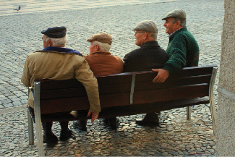
Agenda & Learning Outcomes
Demographic trends in Europe
Three Positive Ageing Frameworks
  Healthy Ageing
  Active Ageing
  Quality of Life
Measurement of Quality of Life
Holistic Well-Being
Professional Challenges
Guidance for Educators and Professionals
What will learners know or be able to do?
Explain the impact of demographic shifts in Europe.
Differentiate between Healthy Ageing, Active Ageing, and Quality of Life models.
Use tools (CASP-19/WHOQOL) to measure wellbeing beyond clinical health.
Apply a Gender and Culture lens to identify barriers faced by older adults.
Balance the Dignity of Risk (Autonomy) against institutional safety (Beneficence).
This photograph by an unknown author is licensed under CC BY.

Slide 3
Demographic Data (Eurostat, 2024)
Ageing in Europe
The EU population is projected to start falling in the coming years while the number of older people is rising (2024 Ageing Report by European Commission, 2024)
The old-age dependency ratio is the ratio of the old-age population related to the working-age population and gives an idea about the shift between potential retirees and potential workers.
The old-age dependency ratio for the EU was 33.9% on 1 January 2024, with just over 3 persons of working age for every person aged 65 years and over.
Notes:
Across EU countries, the ratio ranged from lows of 21.7% in Luxembourg and 23.6% in Ireland, with almost 5 working age persons for every person aged 65+, to highs of 38.4% in Italy and 38.2% in Portugal, where there were fewer than 3 working age persons for every person aged 65+.

Slide 4
Demographic Data (Eurostat, 2024)
Ageing in Europe
According to collected data, the old-age dependency ratio would rise further to 59.0 in 2070, with most of the increase expected already by 2045.
Country | Population 1 January 2024 | Old-age dependency ratio* 2024 | Median age in years 2024 | Increase of persons aged 65+ between 2014 and 2024
Germany | 83.4 million 19% of EU total | 35.2 | 45.5 | 20.9% to 22.4%
France | 68.4 million 15% of EU total | 34.8 | 42.6 | 18.0% to 21.4%
Romania | 19.07 million 4.2% of EU total | 31.2 | 43.8 | 13.9% to 17.7%
Cyprus | 934 000 0.2% of EU total | 26.5 | 40.6 | 16.5% to 20.0%
Portugal | 10.64 million 2.4% of EU total | 38.2 | 47.1 | 20.0% – 24.1%
Europe | 449.31 million | 33.9 | 44.7 | 18.7% to 21.6%

Slide 5
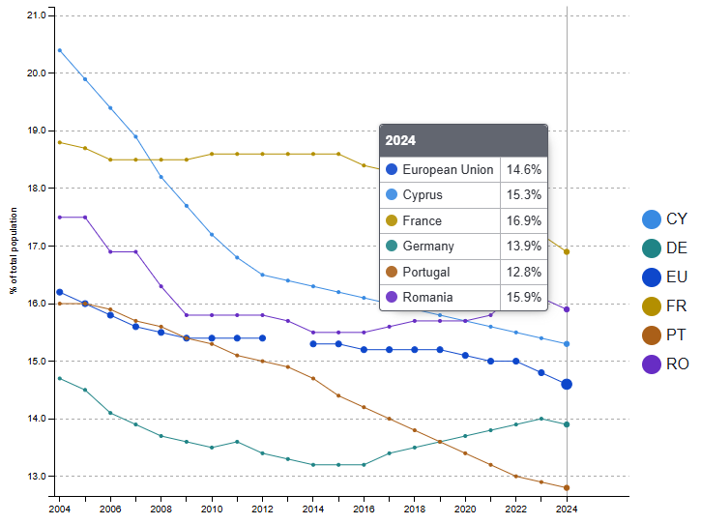
Demographic Data (Eurostat, 2024)
Population aged less than 15 years as % of total population in Never Gets Old Partner Countries

Slide 6





Demographic Data in Partner Countries
Portugal, alongside Italy and Greece, currently records one of the highest old-age dependency ratios in the EU, with its median age increasing at one of the fastest rates in the region (Eurostat, 2024).
Germany has recently experienced a slight stabilisation or decrease in median age, a phenomenon attributed to the influx of a younger migrant workforce.
France continues to maintain one of the largest and most resilient populations; however, it is not immune to the "greying“, which has shifted national policy focus toward the long-term sustainability of social care systems.
Romania has undergone one of the EU’s most significant relative population decreases (approximately -11% since 2004), driven by the emigration of the working-age population
Cyprus has recorded the highest relative population growth in the bloc (29% since 2004), yet it paradoxically faces a shrinking proportion of children.

Slide 7

Demographic Data - Ageing in Europe
The data underscores a transition from a period of demographic bonus (a country has a large, young working population) to one of demographic drag.
In other words: We can no longer rely on having a huge group of young workers to power the economy; instead, we must find new ways to support a much older society.
Notes:
Demographic drag occurs when a shrinking workforce and a growing elderly population slow down a country's economic growth. This happens because there are fewer workers paying taxes to support the rising costs of for example pensions, healthcare, and social services for older citizens.

Slide 8
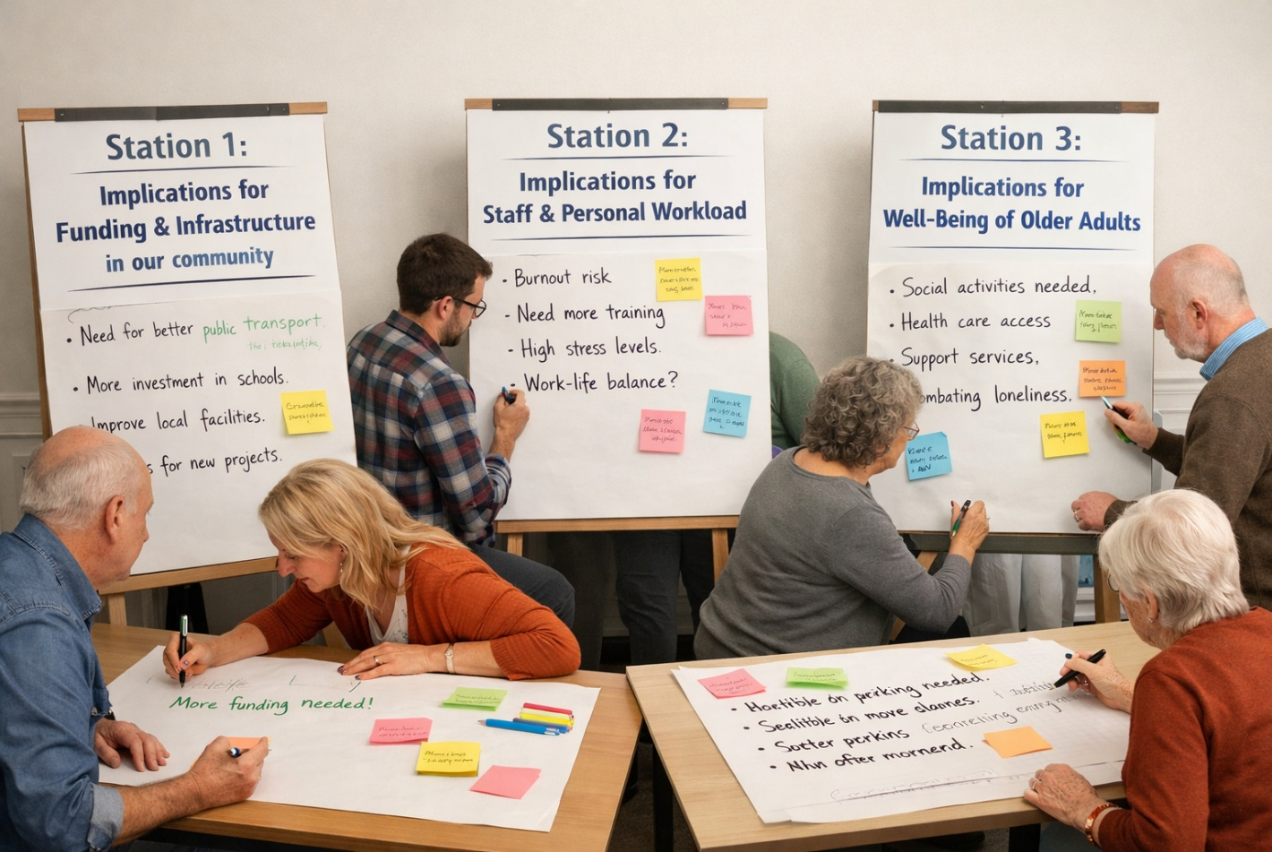
Demographic Data - Ageing in Europe
Exercise 1 – World Café
Objective: Connect the EU data to the learners’ specific regional and professional reality.
Set up three "stations" (tables):
Station 1: Implications for Funding & Infrastructure in our community.
Station 2: Implications for Staff & Personal Workload.
Station 3: Implications for the Well-being of older adults.
Notes:
Groups spend 5 minutes at each station adding their thoughts on paper sheets before rotating. After three rounds, points will be presented and discussed within the whole group. Despite some differences in the numbers between countries, what is one challenge or trend that seems to be the same for all of us? How do these numbers explain what you are seeing every day in your facility or with your residents right now? If you had to pick just one piece of information from these papers to share with a colleague who wasn't here today, which one would it be and why?

Slide 9

Positive Ageing Frameworks
As the European and global population undergoes a demographic shift, the focus of gerontology and social policy has moved from:
A framework provides a way of understanding and can be a tool for organising programmes or services for seniors.
Positive Ageing Frameworks: views ageing as a continued period of growth, development, and potential.
Deficit-based model: views ageing primarily as a period of inevitable decline or illness.

Slide 10
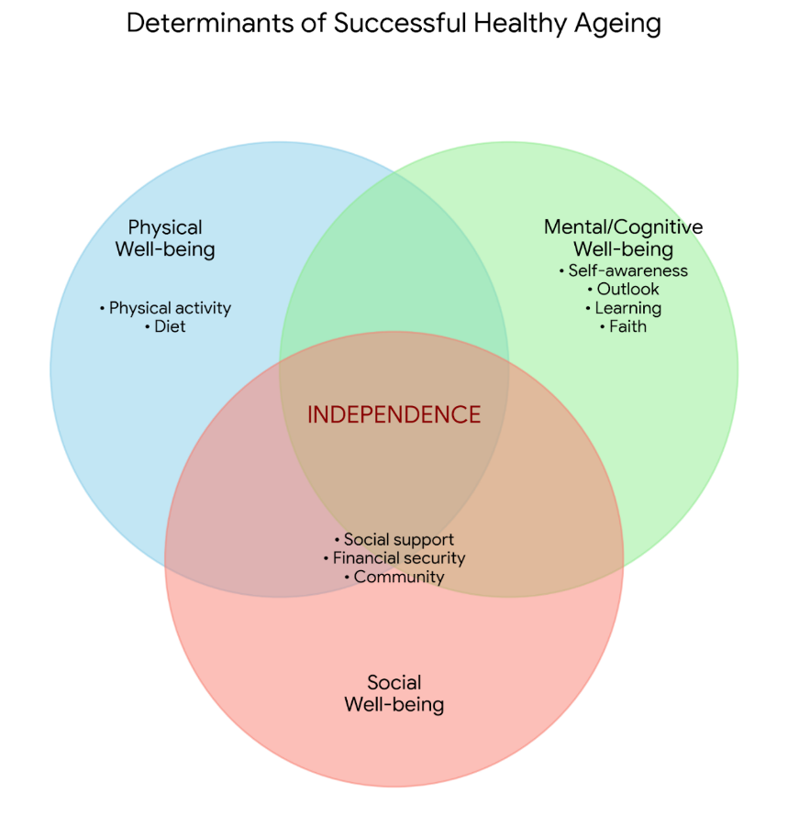
Positive Ageing Frameworks
Healthy Ageing: A Functional Approach
Healthy Ageing is the process of developing and maintaining the functional ability that enables wellbeing in older age (WHO, 2020).
Functional ability is having the capabilities to enable people to be and do what they value (Beard et al., 2016). It is referred to as the ability:
  to meet their basic needs,
  to learn, grow and make decisions,
  to be mobile,
  to build and maintain relationships, and
  to contribute to society.
Data based on Abud et al., 2022.

Slide 11
Positive Ageing Frameworks
Examples of Healthy Ageing
Age-Friendly Urban Infrastructure
Nutritional Security and Preventive Health
Self-Management and Health Advocacy

Slide 12
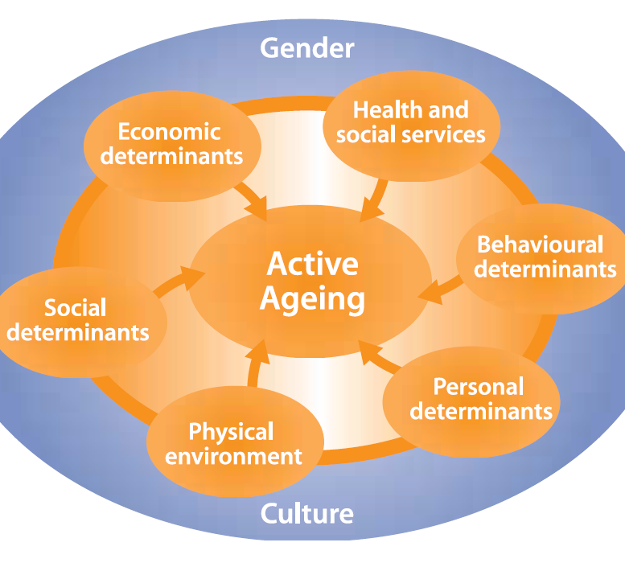
Positive Ageing Frameworks
Active Ageing: Optimising Opportunities
Active Ageing is the process of optimising opportunities for health, participation and security to enhance quality of life as people age (WHO, 2002).
The word active refers to continuing participation in social, economic, cultural, spiritual, and civic affairs, not just the ability to be physically active or participate in the labour force. It rests on three pillars: Health, Participation, and Security.
Notes:
Health and Social Services: Health promotion, disease prevention, long-term care, mental health services.
Behavioural Determinants: Smoking cessation, physical activity, healthy eating, oral health, alcohol consumption, medication.
Personal Determinants: Biology, genetics, psychological factors.
Physical Environment: Age-friendly surroundings, safe housing, fall prevention, absence of pollution (clean water, air, and safe food).
Social Determinants: Social support, education and literacy, preventing violence and abuse.
Economic Determinants: Income, social protection, financial security

Slide 13
Positive Ageing Frameworks
Active Ageing: Optimising Opportunities
Culture serves as the overarching environment for individuals, dictating societal views on the ageing process, health-seeking behaviours, or living arrangements.
Gender functions as a critical lens for policy appropriateness, highlighting how disparate social statuses and traditional roles lead to unique risks: women often face increased poverty due to lifelong unpaid caregiving, while men are statistically more susceptible to occupational hazards and risk-taking behaviours.
Healthy Life Expectancy
Autonomy
Independence
Quality of Life
Notes:
Culture and Gender are classified as cross-cutting determinants because they do not exist in isolation, they act as fundamental factors that shape and influence every other factor of the active ageing framework.

Slide 14
Positive Ageing Frameworks
Examples of Active Ageing
Inter-generational Mentoring
Lifelong Political Advocacy
Senior University

Slide 15

Positive Ageing Frameworks
Quality of Life: The Subjective Experience
Quality of Life is an individual's perception of their position in life in the context of the culture and value systems in which they live and in relation to their goals, expectations, standards and concerns (WHOQOL, 1998).
It serves as a vital indicator of well-being that persists even when physical health declines and is closely tied to the concepts of autonomy (the ability to make one’s own choices) and control over daily routines (Wiggins et al., 2004).
Notes:
While Healthy and Active Ageing frameworks focus on functional capacity and societal participation, the Quality-of-Life framework centres on the individual’s subjective experience of their own existence. Quality of Life measures how satisfied a person feels with their social connections, their sense of dignity, and their ability to pursue self-realisation in later life.

Slide 16
Positive Ageing Frameworks
Examples of Quality of Life
Maintaining Personal Style and Identity
Privacy and Intimacy
Autonomy in Small Decisions

Slide 17

Positive Ageing Frameworks
Measurement of Quality of Life
WHOQOL-BREF: a 26-item questionnaire that assesses four primary domains: physical health, psychological health, social relationships, and environment
(available for download in over 40 languages).
CASP-19: designed for older populations, moving away from health-related indicators to focus on thriving in later life. It measures four theory-based dimensions: Control, Autonomy, Self-realisation, and Pleasure
(available in numerous languages).
Notes:
To measure the subjective experience of ageing, researchers and practitioners typically rely on validated, evidence-based tools that capture the multidimensional nature of well-being. Two of the most globally recognised frameworks for assessing Quality of Life are the WHOQOL-BREF (WHO) and the CASP-19 (Wiggins, 2004).

Slide 18

Measurement of Quality of Life
Exercise 2 – Measuring Quality of Life
Objective: To gain practice in using the WHOQOL-BREF and CASP-19 tools.
Divide learners into pairs and hand out Role Play Persona Cards and printed questionnaires:
one plays the Practitioner
the other the Older Adult.
The Practitioner conducts a 10-minute interview using one of the two questionnaires.
Notes:
After the interviews, impressions, ideas and feedback will be discussed within the whole group.

Slide 19

Holistic Framework in Gerontology
Situating Sexuality and Identity within Holistic Wellbeing
The holistic approach must acknowledge that sexuality and identity are integral to wellbeing and do not “expire” at a certain age
realities of later life involve the continuation of desire, the need for touch, and the maintenance of a sexual self-concept, all of which contribute to psychological resilience
ignoring sexuality or treating it as irrelevant, undermines the autonomy and self-realisation pillars of Quality of Life
holistic support requires a shift in perspective: a dignified life involves the freedom to express their gender identity and sexual orientation, and to pursue intimacy and connection throughout the entire lifespan
Notes:
The holistic approach views ageing not as a series of medical symptoms but acknowledges the interconnectedness of various aspects of a person’s life, including their mental and emotional states, relationships, cultural background, and personal preferences.

Slide 20
Professional Challenges
Translating positive ageing frameworks into daily practicecan present challenges for healthcare and social service professionals
Quality-of-Life framework, which emphasises autonomy and the right to take dignified risks.
Biomedical model, which prioritises safety and risk management.
Example: Supporting an older adult's need for intimacy in a residential setting may conflict with institutional protocols.
Example: Challenge to deliver personalised care within systems, while suffering staff shortages and limited resources.
What are your challenges?

Slide 21
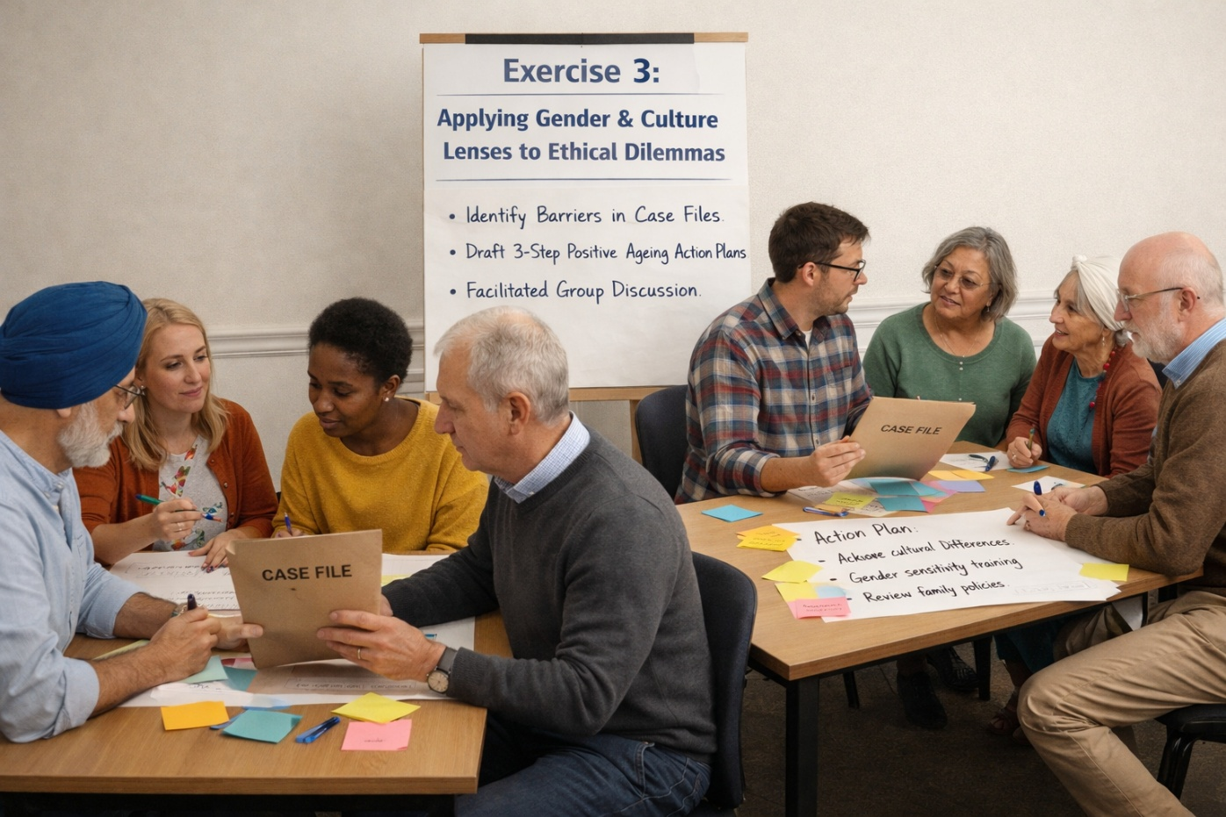
Professional Challenges & Holistic Frameworks
Exercise 3 – Analysing Case Studies and Creating a 3-Step Action Plan
Objective: To apply Gender and Culture lenses and solve ethical dilemmas.
Divide participants into small groups. Each Group is given a Case File and an Action Plan Worksheet. They must complete a two-part task:
Identify how gender and culture are creating barriers in this specific story.
Draft a 3-step action plan to move from a Deficit Model to a Positive Ageing approach for this person.
Notes:
Different cases will be presented to the whole group, including developed action plans.

Slide 22

Guidance for Educators and Professionals
Ethical Considerations & Communication
Beneficence (acting in the person's best interest) vs. Autonomy (respecting their right to choose): Professionals should adopt the Dignity of Risk principle whenever possible, acknowledging that a life without risk is a life without freedom. Ensuring that an older adult can express their sexuality and identity is a fundamental human rights issue.
Validate, don’t infantilise: Avoid "elderspeak" (e.g. using high-pitched tones or overly simplified language). Treat older adults as the autonomous peers they are.
Active listening: Listen for cues regarding a person’s identity, past roles, and current desires. Sexuality and intimacy are often discussed in "shades of grey", subtle hints that require a sensitive, non-judgemental response.

Slide 23
Guidance for Educators and Professionals
Do | Don’t
Use person-first language and speak to the individual as an equal, regardless of their physical or cognitive status. | Don’t use "elderspeak" (baby talk, high-pitched tones, or collective terms like "we") which diminishes a person's dignity.
Encourage shared decision-making, allowing the individual to lead the conversation about their care and daily routines. | Don’t make assumptions about what a person can or cannot do only based on their age or medical diagnosis.
Provide private spaces for the expression of intimacy and gender identity (e.g. knock and wait for a response before entering the room). | Don’t pathologise or ignore an older adult’s sexual health or identity or treat it as inappropriate or a "symptom."
Look at the "whole person," considering their cultural background, spiritual needs, and life history alongside clinical health. | Don’t treat the person as a “case” or a list of medical symptoms; avoid focusing exclusively on biological decline.
Support the "dignity of risk," allowing individuals to make choices that enhance their joy, even if they carry minor risks. | Don’t prioritise institutional safety so heavily that it results in the "social death" or total restriction of the individual.
Ask open-ended questions: "What does 'independence' look like for you today?" | Don’t assume asexuality: Never dismiss a resident’s request for privacy or their expression of gender identity as inappropriate.

Slide 24

Summary and Key Messages
Ageing is a dynamic and multidimensional process rather than a narrative of inevitable decline.
Positive Ageing is achieved through the synergy of Healthy Ageing (functional ability), Active Ageing (participation and security), and Quality of Life (subjective satisfaction).
We have seen that while demographic changes across Europe present economic challenges, the primary focus for professionals must remain on the individual's independence and autonomy.
Identity and sexuality are vital components of wellbeing that require professional recognition and support.

Slide 25
Module 1 – Key Definitions
Ageism: Refers to the stereotypes (how we think), prejudice (how we feel) and discrimination (how we act) towards others or oneself based on age (WHO, 2025).
Old-age Dependency Ratio: A demographic indicator measuring the ratio of older dependents, typically those aged 65+, to the working-age population, usually 15-64 years (Eurostat, 2024).
Healthy Ageing: The process of developing and maintaining the functional ability that enables wellbeing in older age (to be and do what they have reason to value) (WHO, 2020).
Active Ageing: The process of optimising opportunities for health, participation and security to enhance quality of life as people age (WHO, 2002).
Quality of Life: An individual's perception of their position in life in the context of the culture and value systems in which they live and in relation to their goals, expectations, standards and concerns (WHOQOL, 1998).
Gender Lens: A perspective that considers how social statuses, traditional roles, and biological differences affect the wellbeing and opportunities of men, women, and gender-diverse individuals (WHO, 2002).
Holistic Framework in Gerontology: An approach that views ageing not merely as a series of medical symptoms or biological declines but acknowledges the interconnectedness of various aspects of a person’s life, including their mental and emotional states, relationships, cultural background, and personal preferences (Hello Leaders, 2024).

Slide 26



Thank you for your attention!
www.nevergetsold.eu
Never Gets Old
nevergetsold.project

Slide 27
Module 1: Ageing Population and Positive Approaches to Ageing
References
Abud, T., Kounidas, G., Martin, K. R., Werth, M., Cooper, K., & Myint, P. K. (2022). Determinants of healthy ageing: a systematic review of contemporary literature. Aging clinical and experimental research, 34(6), 1215-1223.
Beard, J. R., Officer, A., De Carvalho, I. A., Sadana, R., Pot, A. M., Michel, J. P., ... & Chatterji, S. (2016). The World report on ageing and health: a policy framework for healthy ageing. The lancet, 387(10033), 2145-2154.
De Gobbi, M. S., Kühn, S., Heins, G., & Malikova, Z. (2025). Demographic change in Europe and Central Asia: Addressing the issue of a shrinking and ageing labour force (No. 139). ILO Working Paper. https://www.econstor.eu/bitstream/10419/324229/1/1929162480.pdf
European Commission. (2024). The 2024 Ageing Report: Economic and Budgetary Projections for the EU Member States (2022–2070) (Institutional Paper 279). Publications Office of the European Union. https://doi.org/10.2765/049223
European Commission. (2021). Green paper on ageing: Fostering solidarity and responsibility between generations. https://commission.europa.eu/system/files/2021-06/green_paper_ageing_2021_en.pdf
Eurostat. (2024, September). Population structure and ageing. European Commission. https://ec.europa.eu/eurostat/statistics-explained/index.php?title=Population_structure_and_ageing
Eurostat. (2025). Demography of Europe – 2025 edition. Interactive publication. https://ec.europa.eu/eurostat/web/interactive-publications/demography-2025
Gewirtz-Meydan, A., & Ayalon, L. (2020). “Shades of grey”: Exploring public opinion about later-life sexuality. Canadian Journal on Aging/La Revue canadienne du vieillissement, 39(4), 647-661. https://doi.org/10.1017/s071498081900062x
Gewirtz-Meydan, A., Hafford-Letchfield, T., Benyamini, Y., Phelan, A., Jackson, J. and Ayalon, L. (2018) 'Ageism and Sexuality', in Ayalon, L. & Tesch-Römer, C. (eds.) Contemporary Perspectives on Ageism. Cham: Springer International Publishing, pp. 149-162. doi:10.1007/978-3-319-73820-8_10. https://cora.ucc.ie/bitstreams/7f056dc8-2801-4587-9aec-87a10ad79796/download
Hello Leaders. (2024, March 13). Holistic care: A comprehensive approach to well-being in the aged care sector. https://helloleaders.com.au/article/holistic-care-a-comprehensive-approach-to-well-being-in-the-aged-care-sector
Paúl, C., Ribeiro, O., & Teixeira, L. (2012). Active ageing: An empirical approach to the WHO model. Current Gerontology and Geriatrics Research, 2012, 1–10. https://doi.org/10.1155/2012/382972
Ribeiro, M. G. (2025, June 26). Active ageing: European frameworks and progress. European Association for the Education of Adults. https://eaea.org/2025/06/26/active-ageing-european-frameworks-and-progress/
Rudnicka, E., Napierała, P., Podfigurna, A., Męczekalski, B., Smolarczyk, R., & Grymowicz, M. (2020). The World Health Organization (WHO) approach to healthy ageing. Maturitas, 139, 6-11. https://doi.org/10.1016/j.maturitas.2020.05.018
THE WHOQOL GROUP. (1998). Development of the World Health Organization WHOQOL-BREF Quality of Life Assessment. Psychological Medicine, 28(3), 551–558. doi:10.1017/S0033291798006667
Wiggins, R. D., Netuveli, G., Hyde, M., Higgs, P., & Blane, D. (2004). The Casp-19 scale of quality of life in old age: its measurement properties, reliability and validity. Ageing & Society, 24(5), 693–706.
World Health Organization. (2025, April 28). Ageing: Ageism. https://www.who.int/news-room/questions-and-answers/item/ageing-ageism
World Health Organization. (2020). Decade of healthy ageing: Baseline report. https://www.who.int/publications/i/item/9789240017900
World Health Organization. (2002). Active ageing: A policy framework (No. WHO/NMH/NPH/02.8). World Health Organization.

