Slide 1
Module 8 – Dementia and Sexuality: Critical Points
Developed by Cristina-Ioana Apostu/ SRA

Slide 2
Why This Topic Is Difficult?
Discomfort around sexuality in later life
Incertainty about autonomy in dementia
Family concerns and protective reactions
Fear of legal or professional consequences

Slide 3
We are asking the wrong question
❌ “Should people with dementia have sexual relationships?”
⬇
✅ “How can we support autonomy while ensuring safety?”

Slide 4
Sexuality Is Not Just Intercourse
Sexuality includes:
Touch
Emotional intimacy
Identity
Orientation
Desire for connection
Removing intimacy can increase distress.

Slide 5
Myths
Common Myths:
❌“People with dementia are asexual”
❌“Any sexual behaviour is inappropriate”
❌“Protection means stopping all intimacy”
❌“Older people no longer need closeness”

Slide 6
What We Know in Practice
Reality
✅ The need for intimacy often remains
✅ Not all behaviour is problematic
✅ Many expressions of closeness are meaningful
✅ Good care means balancing safety and autonomy

Slide 7
Types of Dementia (Clinically Relevant for Consent)
Alzheimer’s Disease→ memory impairment
Frontotemporal Dementia →disinhibition → high ethical complexity
Vascular Dementia → executive dysfunction → difficulty weighing consequences
Lewy Body → Fluctuating cognition → consent may fluctuate
Diagnosis matters.

Slide 8
Alzheimer’s Disease
Primarily affects memory
Person may forget relationships or context
Can lead to confusion about who others are
Emotional needs often remain
Impact:
May seek closeness for comfort
Risk of misunderstanding situations

Slide 9
Frontotemporal Dementia
Changes in behaviour and social awareness
Disinhibition and impulsivity
Reduced empathy and judgment
Limited awareness of consequences
Impact:
Increased risk of inappropriate behaviour
Consent may be affected → needs careful assessment

Slide 10
Vascular Dementia
Difficulties with planning and decision-making
Slower thinking and processing
Reduced ability to weigh consequences
Impact:
May struggle to make informed decisions
Needs support in understanding situations

Slide 11
Lewy Body Dementia
Fluctuating attention and awareness
Periods of clarity followed by confusion
Possible visual hallucinations
Impact:
Capacity may change from day to day
Consent must be assessed in the moment

Slide 12
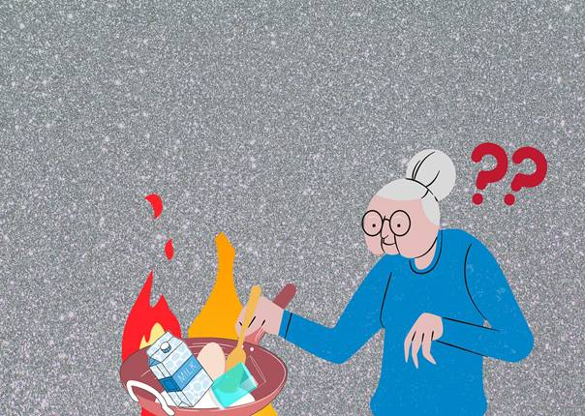
Why this matters?
Dementia is not just about memory.
Decision-making
Social judgment
Impulse control
Emotional regulation
This affects how people behave, relate, and give consent.

Slide 13
Common Patterns of Sexual Change
1. Reduced Sexual Interest
2. Increased Sexual Behaviour (Hypersexuality)
3. Relational Confusion

Slide 14
Sexual Behaviour Changes in Dementia
Sexual changes vary depending on:
• Brain regions affected
• Type of dementia
• Medication effects
• Personality traits
• Environmental context
Not all behavioural changes are intentional or sexually motivated

Slide 15

Hypersexuality & Medication
Especially relevant in:
Parkinson’s disease
Lewy Body Dementia
Dopaminergic treatment
Clinical review may be required before restriction.

Slide 16
Behavioural Disinhibition
May include:
• Inappropriate touching
• Explicit language
• Public masturbation
• Reduced social judgment
These behaviours often reflect frontal lobe dysfunction, not moral intent.

Slide 17
Frontotemporal Dementia – Main Features
Behavioral disinhibition
Impaired social judgment and empathy
Impulsivity and loss of self-control
Neglect of personal hygiene
Repetitive behaviors and hyperorality
Language disturbances
Memory may be relatively preserved in the early stages.

Slide 18
Frontotemporal Dementia and Consent
Disinhibition → inappropriate sexual behaviors
Impaired judgment → difficulty evaluating consequences
Impulsivity → rapid, unfiltered behaviors
Lack of insight → the person is unaware of the illness
⚠️ Clinical implication
Capacity for consent may be affected, but must be assessed individually, not assumed automatically.

Slide 19
Capacity vs Consent: A Crucial Distinction
Capacity = ability to make a decision.
Consent = agreement to engage in a specific act or relationship.
👉 Capacity is assessed
👉 Consent is given (or withdrawn)
A dementia diagnosis does not automatically remove either.

Slide 20
What Is Decision-Making Capacity?
Capacity is:
• Decision-specific
• Time-specific
• Context-dependent
• Not diagnosis-based

Slide 21
Capacity in real life
A person may:
struggle with financial decisions
but still make choices about relationships.
Capacity may fluctuate — especially in Lewy Body or Parkinson’s Disease Dementia.

Slide 22
The 4 Clinical Consent Questions
1. Does the person understand the nature of the relationship?
Can they appreciate possible consequences?
Can they communicate a voluntary choice?
Is there absence of distress or coercion?
If YES → autonomy prevails.
If NO → safeguarding response.
Consent can be withdrawn at any time.
Silence does not mean consent.
Notes:
Intelegerea naturii relatiei: de exemplu, persoana trebuie sa inteleaga cine este cealalta persoana: partener, sot/sotie sau o persoana straina. Daca un pacient crede ca ingrijitorul este partenerul lui, atunci nu vorbim despre consimtamant valid.
Aprecierea consecintelor: de exemplu, sa inteleaga ca relatia implica intimitate, apropiere emotionala sau eventuale consecinte. Daca persoana nu realizeaza ce implica gesturile respective, capacitatea este afectata.
Comunicarea unei alegeri voluntare: persoana trebuie sa spuna clar da sau nu
Absenta coercitiei: daca persoana pare speriata sau confuza, atunci nu mai putem vb despre consimtamant.

Slide 23
Ethical Decision-Making in Dementia and Sexuality
Balance: Autonomy ↔ Protection
Autonomy→ Respect choices & relationships
Beneficence→ Support comfort & wellbeing
Non-maleficence→ Prevent harm
Justice→ Treat fairly, avoid discrimination
Avoid ageism and respect dignity regardless of cognitive status

Slide 24
Why This Distinction Matters
Confusing capacity with consent may lead to:
• Unnecessary restriction
• Institutional overprotection
• Violation of autonomy
Ethical practice requires structured capacity assessment — not moral judgment.

Slide 25

Red Flags (When to Intervene)
Clear distress
Fear or avoidance
Exploitation patterns
Severe cognitive inability
to understand situation
Protection must be proportionate.

Slide 26
⚖Professional and Proportionate Response
Low Risk | High Risk
Consensual affection | Lack of clear consent
Mutual romantic interes | Lack of decision-making capacity
 | Pressure, intrusive advances
 | Risk of exploitation or abuse

Slide 27
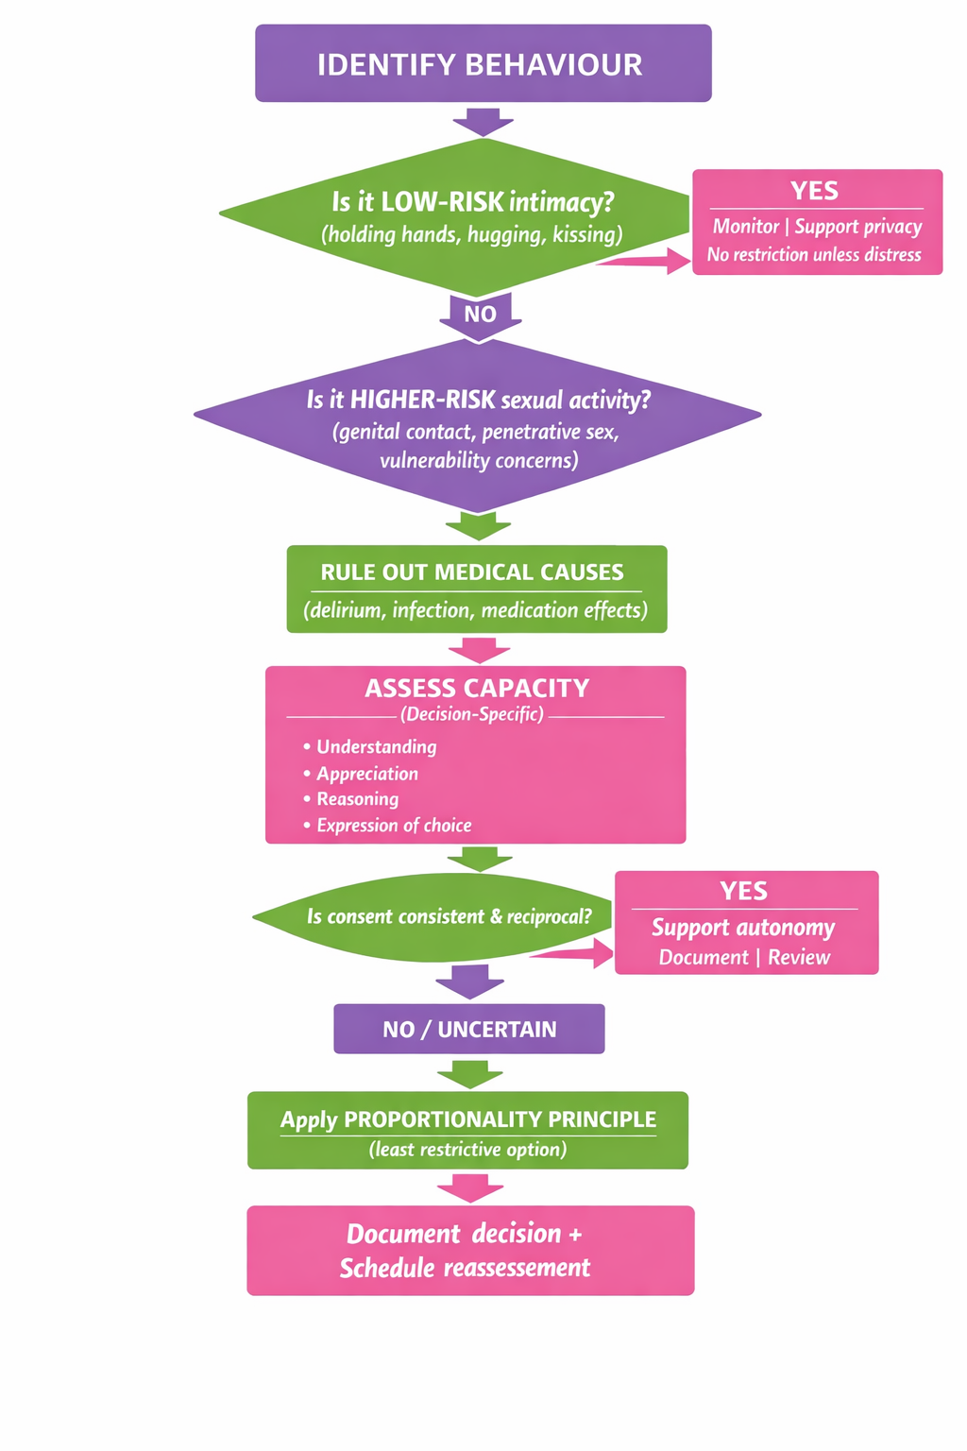

Slide 28
Safeguarding Without Stigmatization
Intervene only when:
Harm risk exists
Capacity absent
Coercion present
Least restrictive option first ⚠

Slide 29
Family Resistance
Common statements:
“She doesn’t know what she’s doing.”
“He’s too old for this.”
“This is inappropriate.”
But age ≠ incapacity.

Slide 30
Institutional Responsibility
Care homes must:
Develop clear policies
Train staff
Document assessments
Avoid blanket prohibitions
Silence increases risk

Slide 31
🎞 Guidance for Family Members
Why it matters
Family = main care environment
Intimacy & behaviour changes happen at home
Caregivers often feel unprepared
Common reactions
Discomfort
Confusion
Emotional conflict
Support = understanding, not control

Slide 32
🎞Understanding & Responding
Key question: “What is this behaviour communicating?”
Possible meanings:
Need for closeness
Loneliness / fear
Confusion about relationships
Reduced impulse control

Slide 33
At home
Ensure privacy & dignity
Maintain routines
Stay calm
Gentle redirection
Reassurance, not correction
Dementia ≠ loss of need for connection

Slide 34
Boundaries & When to Seek Help
Balance is key
Not all intimacy = risk
Observe comfort vs distress
When to seek help:
Sudden behaviour changes
Distress or risk is present
Consent is unclear
Caregiver feels overwhelmed

Slide 35
Inclusive Perspective
Older adults may also be:
LGBTQ+*
Widowed and forming new relationships*
Seeking emotional companionship
Dementia does not erase identity⚠

Slide 36
🔒 Supporting Privacy and Intimacy in Care Environments
Barriers in care settings
Shared spaces & rigid routines
Risk-averse practices
Staff interruptions
Misinterpretation of intimacy
Inclusive practice
Access to private / adaptable spaces
Time for couples without interruption
Flexible visiting arrangements
Respect for affection and closeness
Privacy is not a luxury — it is a care standard.

Slide 37
Table 1. Do’s and Don’ts in Professional Practice
Do | Don’t
✔ Acknowledge sexuality and intimacy as part of human wellbeing across the life course | ✖ Assume that people living with dementia are asexual or incapable of intimacy
✔ Approach situations with openness and curiosity rather than judgement | ✖ Automatically label expressions of sexuality as inappropriate or problematic
✔ Consider personal history, relationships and emotional needs | ✖ Rely on blanket restrictions instead of individual assessment
✔ Involve the person living with dementia in decisions whenever possible | ✖ Allow personal discomfort or moral beliefs to guide professional decisions
✔ Seek multidisciplinary input when ethical uncertainty arises | ✖ Ignore or silence expressions of need for closeness and affection
✔ Assess consent using a decision-specific and relational approach | ✘ Attribute all behavioural changes solely to dementia without medical evaluation
✔ Rule out reversible medical causes (e.g., delirium, infection, medication effects) when behaviours change | ✘ Use punitive or shaming responses to sexualised behavior
✔ Review current treatments and consider side effects that may influence behaviour | ✘ Override possible consent without structured assessment
✔ Take into account comorbidities (psychiatric conditions, neurological disorders, chronic pain) when evaluating sexual behaviour
✔ Manage inappropriate behaviours proportionately, focusing on understanding triggers before applying restriction

Slide 38
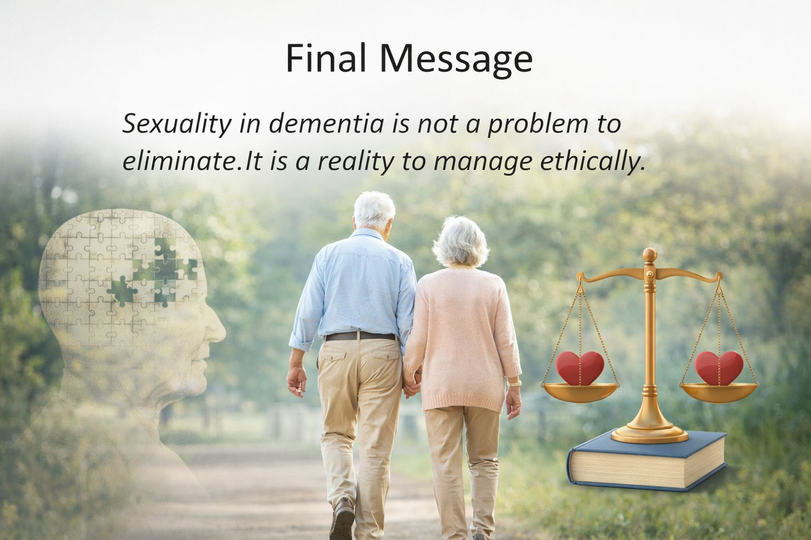
Key Messages
Dementia ≠ automatic incapacity
Family discomfort ≠ safeguarding necessity
Consent assessment must be structured
Least restrictive option first

Slide 39
Thank you!

